Slide 1

Exploring Quantum Magnetism through Neutron Scattering
Collin Broholm,
Johns Hopkins University and NIST Center for Neutron Research
What is Quantum Magnetism?
Where do we find it?
Why is it interesting?
Summary & Prospects
Notes:
Thank you for that introduction and I thank the department and Notre dame University for the hospitality during my brief stay here.
My aim with this talk is to convince you that within the confines of a crystalline solid can exist very real and unique quantum particles. Expanding on the familiar repertoire of fundamental particles, I shall provide concrete experimental evidence magnons, spinons, solitons, and breathers via neutron scattering experiments.
We shall see that these particles embody the collective degrees of freedom of interacting quantum spins on a lattice. They describe physics over a range of energies that we can access and determine through experiments. We shall be particularly interested in the so called quantum critical limit that marks the demise of one set of quasi-particles in favor of another.
I invite your questions throughout.

Slide 2
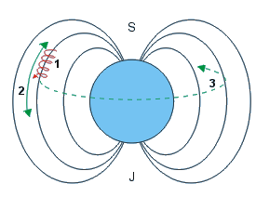
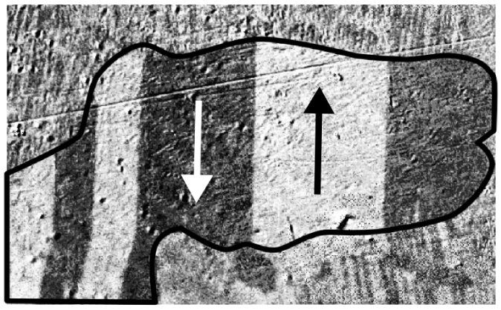
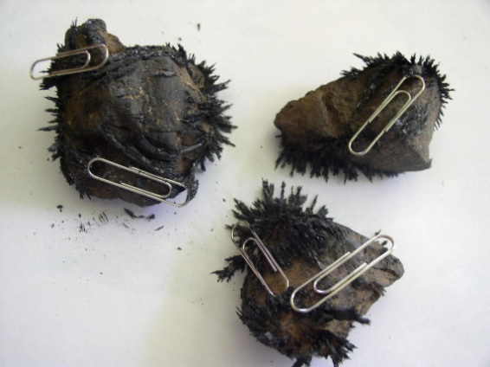
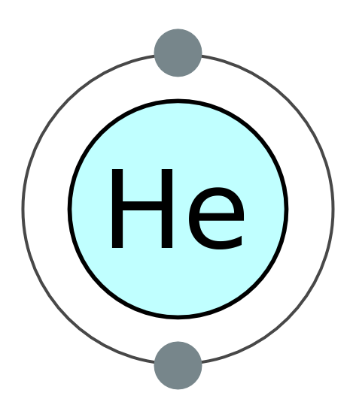
Magnetism & Quantum Magnetism
Ferromagnetism : Fundamental & essential collective phenomenon
  macroscopic semi-classical dynamics
Non-magnetic materials: intra-atomic singlet formation
Quantum Magnetism:
  Inter-atomic singlet formation
  Macroscopic singlet formation
  Strong correlations without static order
  Emergent quantum particles
  Quantum T=0 Phase Transitions

Slide 3
Overview of quantum magnetism
Fundamental Questions:
  What types of collective phases are possible
  What are the corresponding quasi-particles
Elements of the research
  Materials Synthesis (bulk and nano-structured)
  Advanced Characterization
  Theory
Applications
  Model systems for quantum correlated physics
  Sensors and filters via strong collective response
  Quantum computing by manipulating emergent quasi-particles

Slide 4
Probing matter through scattering
Intensity
Single Particle
Process
ћω
Intensity
Multi Particle
Process
ћω
Notes:
The story starts with a description of my preferred experimental technique, which is neutron scattering.
To appreciate the world around us we rely on vision: Our retina receives scattered light and the information is processed to we can understand and react to the surroundings.
To appreciate the world at the atomic scale we scatter radiation with the appropriate wave length and energy in this case neutrons. Energy and momentum is conserved in the scattering process. This allows us to infer the amount of momentum and energy delivered to the sample.
Neutron spectroscopy then consist of measuring the probability of scattering versus momentum and energy transfer to the sample.
I want to focus here on two modes of scattering: In a single particle process all momentum and energy is delivered (or extracted) from a single particle in the material. In that case specifying momentum transfer implies a unique energy transfer.
In a two particle process the energy and momentum brought forward by the neutron is shared between two particles. Even though each particle has a well defined energy momentum relationship, there is a range of energies at which the neutron can scatter for a fixed momentum transfer.
In the experiment we infer the number of particles and their properties by the pattern of scattering in energy momentum space. There are analogies to experimental particle physics except the number of unique particles per experimentalist is considerably larger.

Slide 5

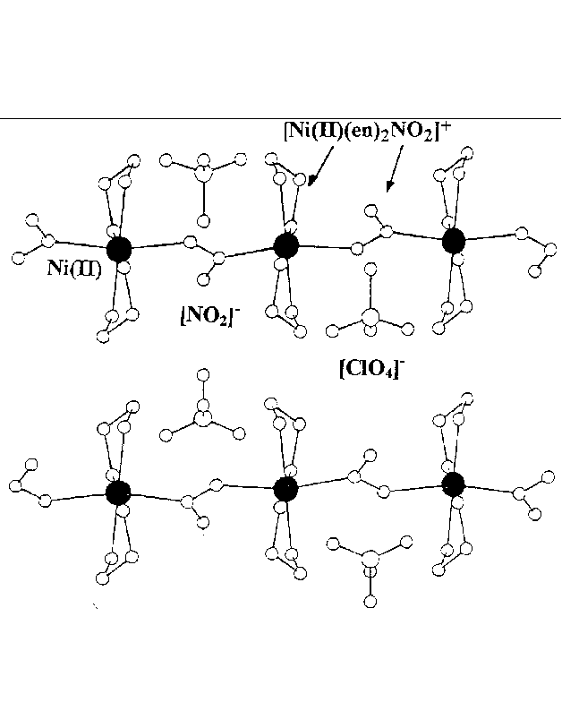
Quasi-particles “live” within solids
Bound spinons in spin-1 chain
Free spinons in spin-1/2 chain
≈ 40 mm
≈ 10 mm
Y₂BaNiO₅
Cu(C₄D₄N₂)(NO₃)₂
≈ 0.1 mm
ZnCr₂O₄
Cu₂(quinox)₂Cl₄
Notes:
Here are images of several samples that I have recently studied. You will notice that individual crystal dimensions span more than two orders of magnitude. Because large crystals are the exception it is fair to say that most interesting physics lurks in small single crystals.
Indeed I am very interested in exploring bound spinons in the spin-1/2 ladder because of the apparent connection to the spin gap in striped phases of high Tc superconductors. Unfortunately the best spin ladder material comes in dimensions of only 100 microns. The valiant efforts of a JHU undergraduate students to align 500 monoclinic crystals not withstanding, we have had to conclude that current instrumentation simply cannot provide information about magnetic excitations in this interesting material.
It is projects like these that have motivated our efforts to develop higher sensitivity instrumentation.

Slide 6



Acknowledgements
G. Aeppli UCL
C. D. Batista Los Alamos
Y. Chen NIST
D. C. Dender NIST
T. Hong ORNL
M. Kenzelmann PSI
C. P. Landee Clarke University
K. Lefmann Copenhagen Univ.
Y. Qiu NIST & Univ. of Maryland
D. H. Reich JHU
C. Rische Univ. of Copenhagen
J. Abalardo-Rodriguez NIST & Univ. of Maryland
C. Stock ISIS
M. B. Stone Penn State University
M. M. Turnbull Clarke University
G. Xu BNL
I. Zaliznyak BNL
Y. Zhao JHU
+ many more friends & colleagues
Notes:
I would like to acknowledge this group of collaborators that made this work possible. In particular I have enjoyed a close collaboration with Dan Reich on this subject area for more than a decade now. Gabriel Aeppli, my former thesis advisor also remains a collaborator. Materials and ideas fro new materials come from Landee and Turnbull of Clark University. Five JHU students and post docs have carried out most though not all of the hard work. Finally we collaborated with former colleagues in Denmark on the exact diagonalization work that I will also describe.
The experiments were performed at the NIST center for Neutron Research and the research was funded by the National Science Foundation.

Slide 7
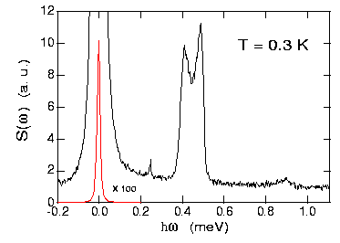
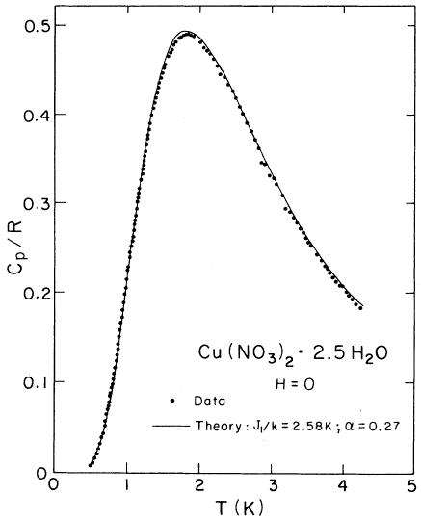
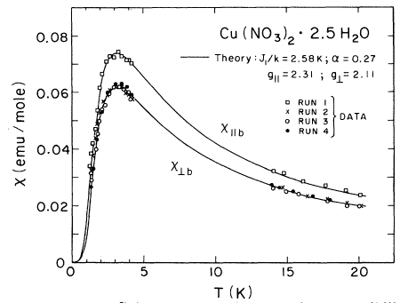
Decoupled spin pairs: singlet ground state
Notes:
You see a pair of spins with antiferromagnetic interactions have an isolated singlet ground state that is completely isotropic in spin space a far cry from the Neel state
The data shows remarkable bulk properties magnetism goes away. The behavior is much like a that of helium atom. There are two electrons but they form a singlet state and hence magnetism is not appreciable.
However in these systems we are looking at inter-atomic singlet formation. The singlet wave function extends over multiple atoms and in general throughout the sample! There are important conceptual and practical implications of this that we shall explore through this talk.

Slide 8
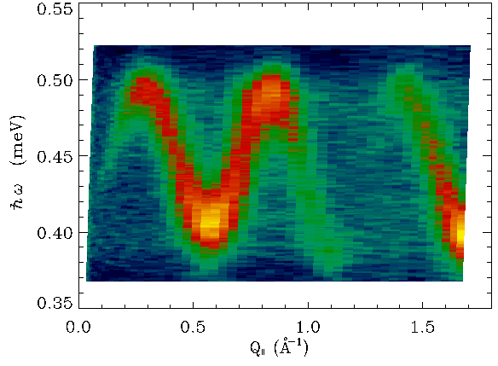
A mobile triplet exciton
Xu et al PRL (2000)
Notes:
When instead of plotting the angle integrated intensity we resolve the data versus wave vector transfer along the direction of the interacting pairs one finds this beautiful pattern of scattering. We understand that the spikes in the previous pattern are due to van-hove singularities at the extremes of the dispersive spectrum. The dispersion in turn indicates that neutrons create excitations that physically move through the crystal. We will see that the pattern of intensity provides information about the atomic scale structure of the wave packet in motion.

Slide 9
Description of weakly interacting dimers
A spin-1/2 pair with AFM exchange has a singlet - triplet gap:
J
Inter-dimer coupling allows coherent triplet propagation and produces well defined dispersion relation
Triplets can also be produced in pairs with total S_{tot}=1
Notes:
But a second type of excited state is also possible: triplets can be produced in pairs. Because each triplet can carry a different part of the total wave vector transfer in the scattering process, these should be expected to produce a spectrum of scattering at any wave vector transfer.
Now in the limit of no inter-dimer coupling the two triplon state is not an excited state of the system. As we turn on weak inter-triplet coupling we therefore expect the two magnon process to have a very small matrix element.

Slide 10
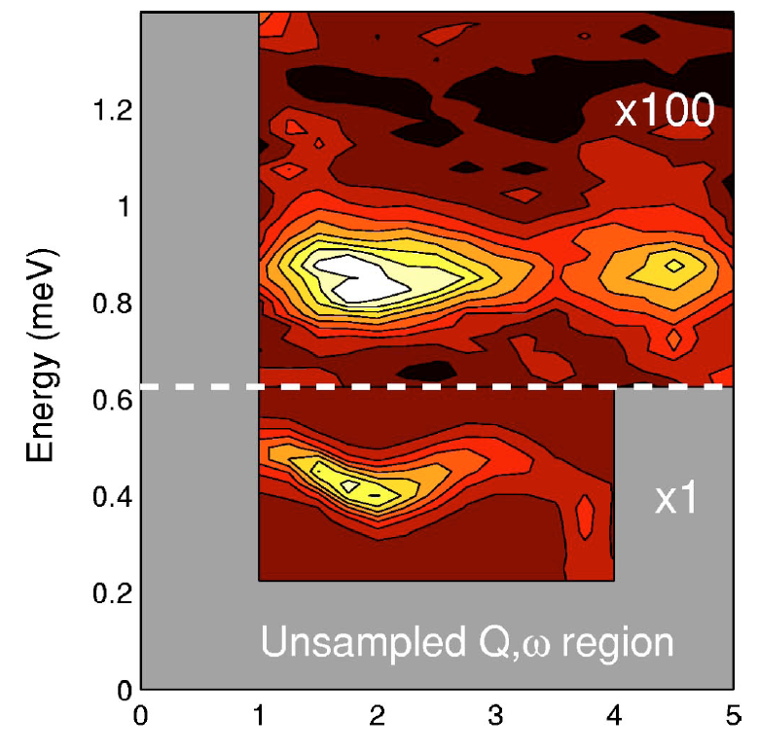

Creating two triplets with one neutron
Two magnons
One magnon
Tennant et al (2000)
Notes:
Here I show experimental evidence for such two magnon states in the alternating spin chain. To the left I show the spectrum of neutron scattering at wave-vector transfer q=2pi. We see elastic nuclear incoherent scattering, uninteresting here but inevitable. Then around 0.5 meV lies the single triplet creation peak, and at twice this energy there is a weak additional peak from triplet pair production. The right hand frames focus on the pair production peaks at 2pi and 3 pi and provide evidence for a spectrum that is significantly broader than the resolution shown with the solid bar in the top frame.
On the right we show data for several values of wave vector transfer in the form of a color contour map of intensity. It is clearly seen that the two magnon excitations are broader in energy than the resolution limited triplet mode as expected. In addition the data is consistent with but does not provide independent evidence for a triplet bound state at q=3pi.

Slide 11
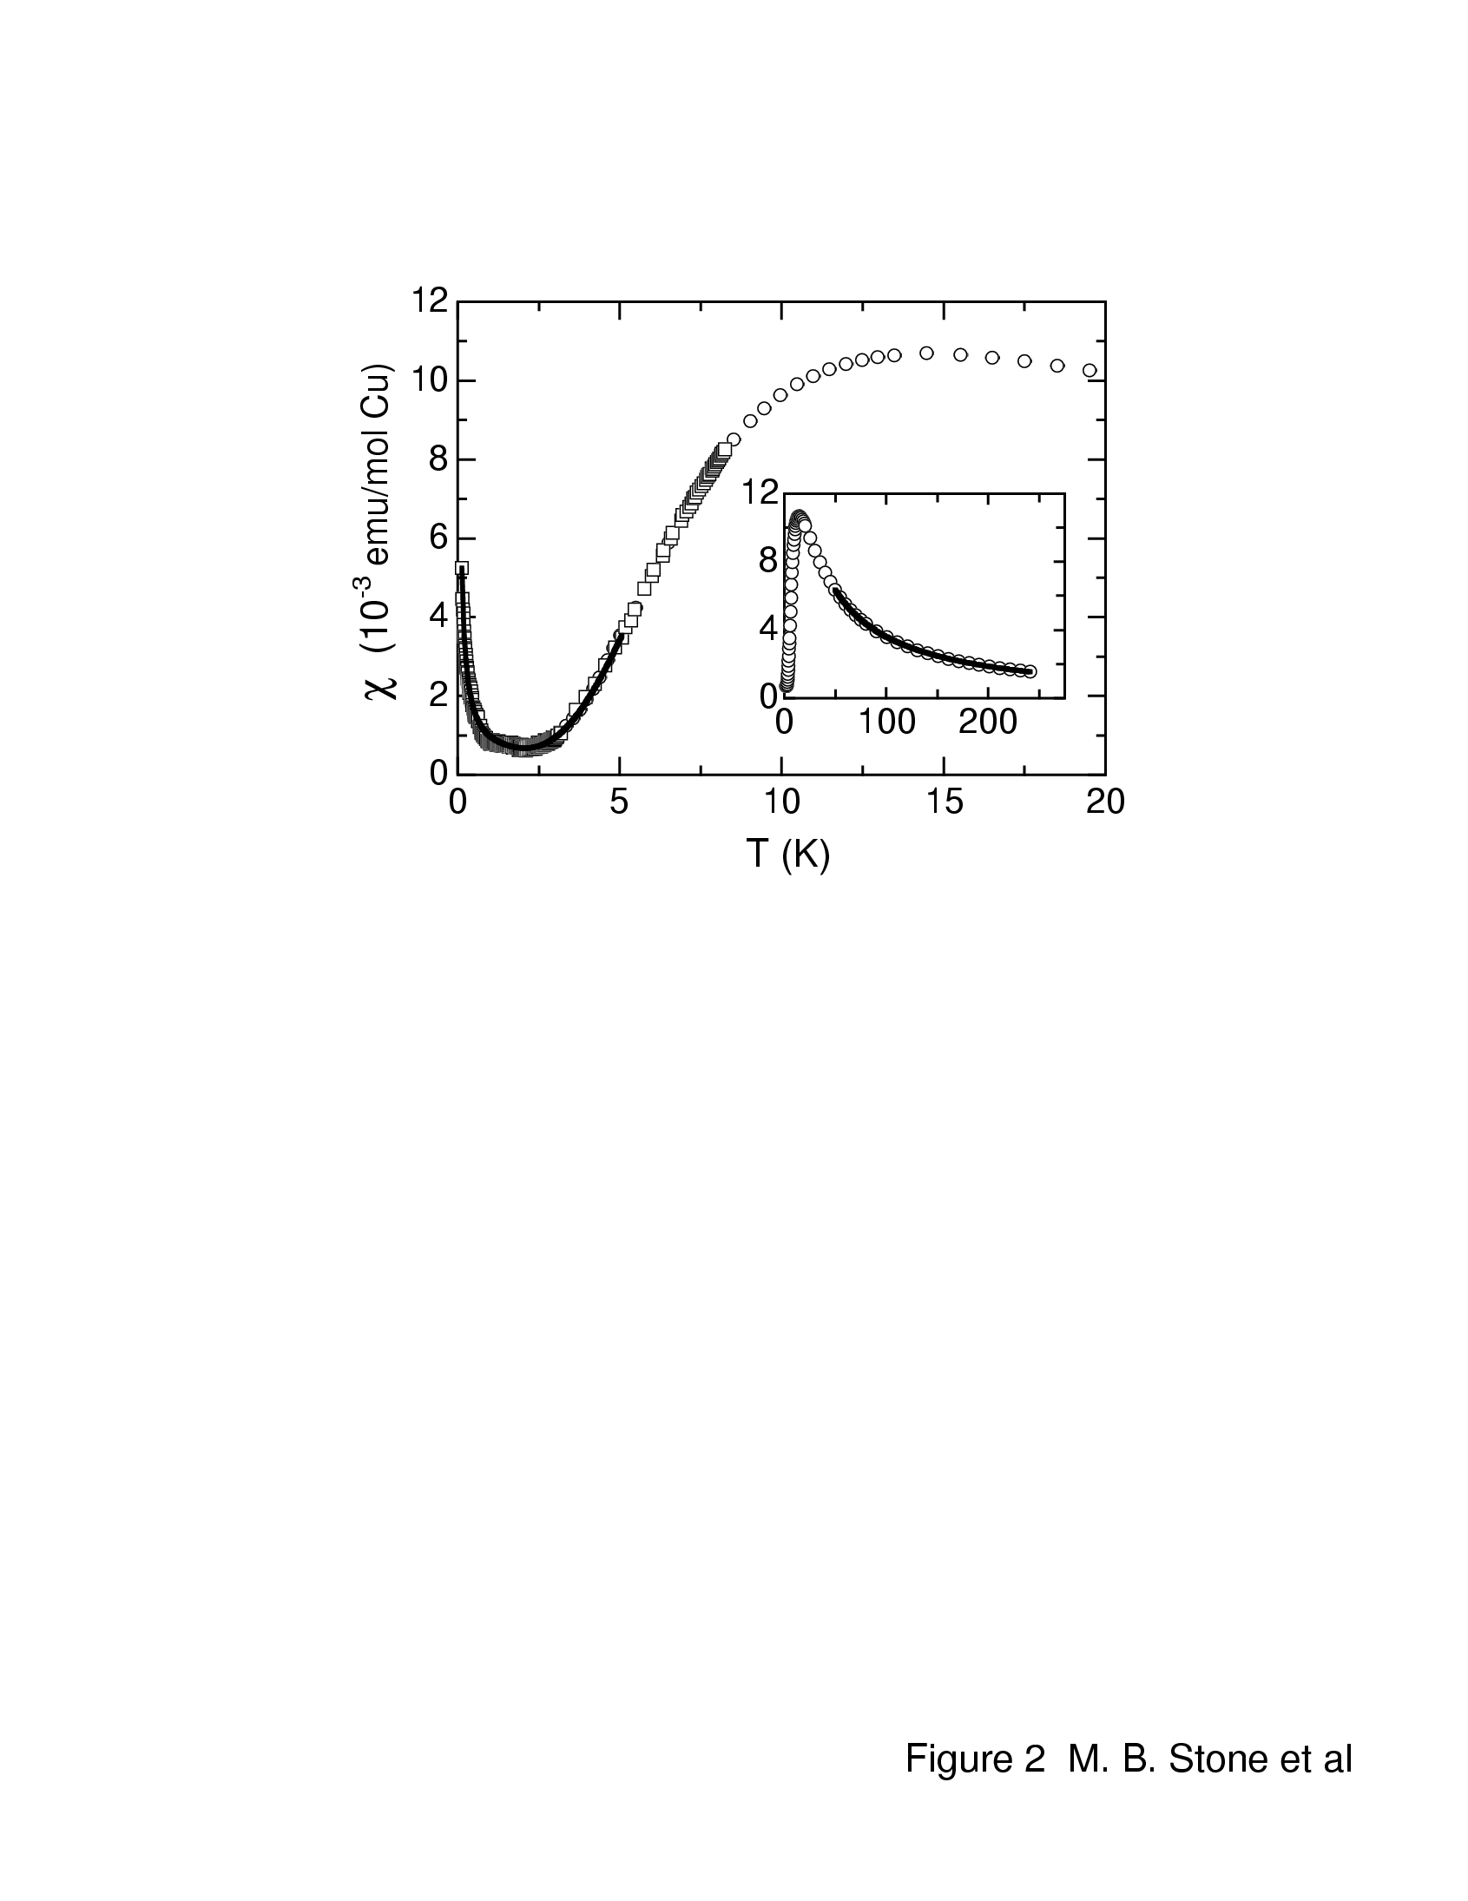
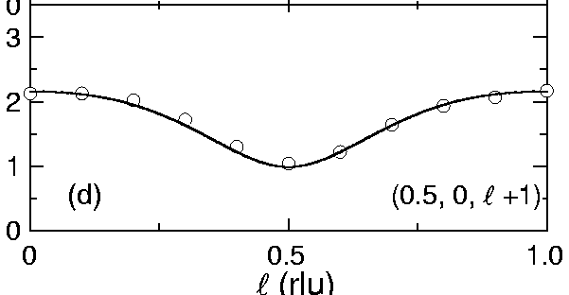
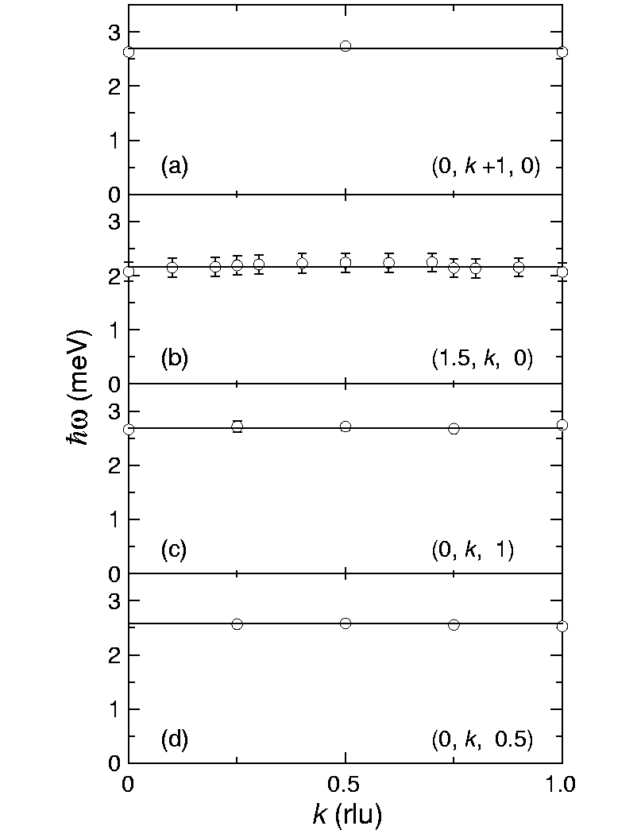
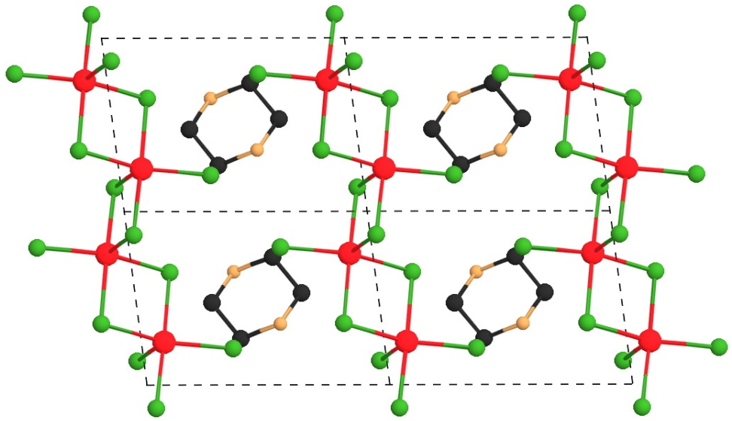
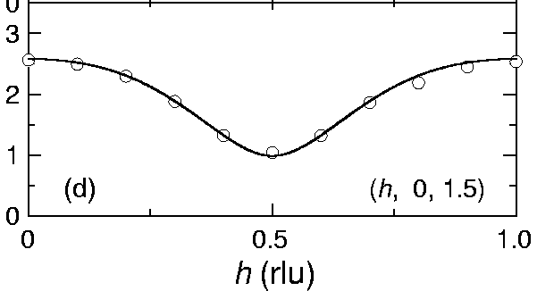
Strongly Interacting Dimers in PHCC
hω (meV)
(C₄H₁₂N₂)Cu₂Cl₆ (PHCC)
Stone et al. PRB (2001)
Notes:
Enter Piprazimium hexachloro dicuprate. It is an organometallic magnet wherein a binuclear molecule with two Cu2+ atoms are coupled so they form a quasi-two dimensional magnet. The susceptibility data is shown top left and clearly reveals gap in the excitation spectrum. The interesting thing about this material which is already revealed by the susceptibility data is that the gap is small compared for example with the Curie Weiss temperature hence this material is an excellent candidate for experimental obeservation of spectrum termination in a quantum magnet.
At q=pi there is a well defined sharp mode in the dispersion relation and one readily traces the dispersion relation throughout the two dimensional Brillouin zone. I want to point out three important features of these data
There is a single mode at each wave vector with anisotropy splitting that is less than 0.1 meV.
There is no dispersion in the b-direction which comes out of the page and this indicates a highly two dimensional material.
The gap is 1 meV and the zone boundary mode lies well above 2 meV so there is the potential for a point of spectrum termination in this system.
Now in the direction of reciprocal space shown here no intersection occurs between the sharp mode and the lower bound of the continuum.

Slide 12
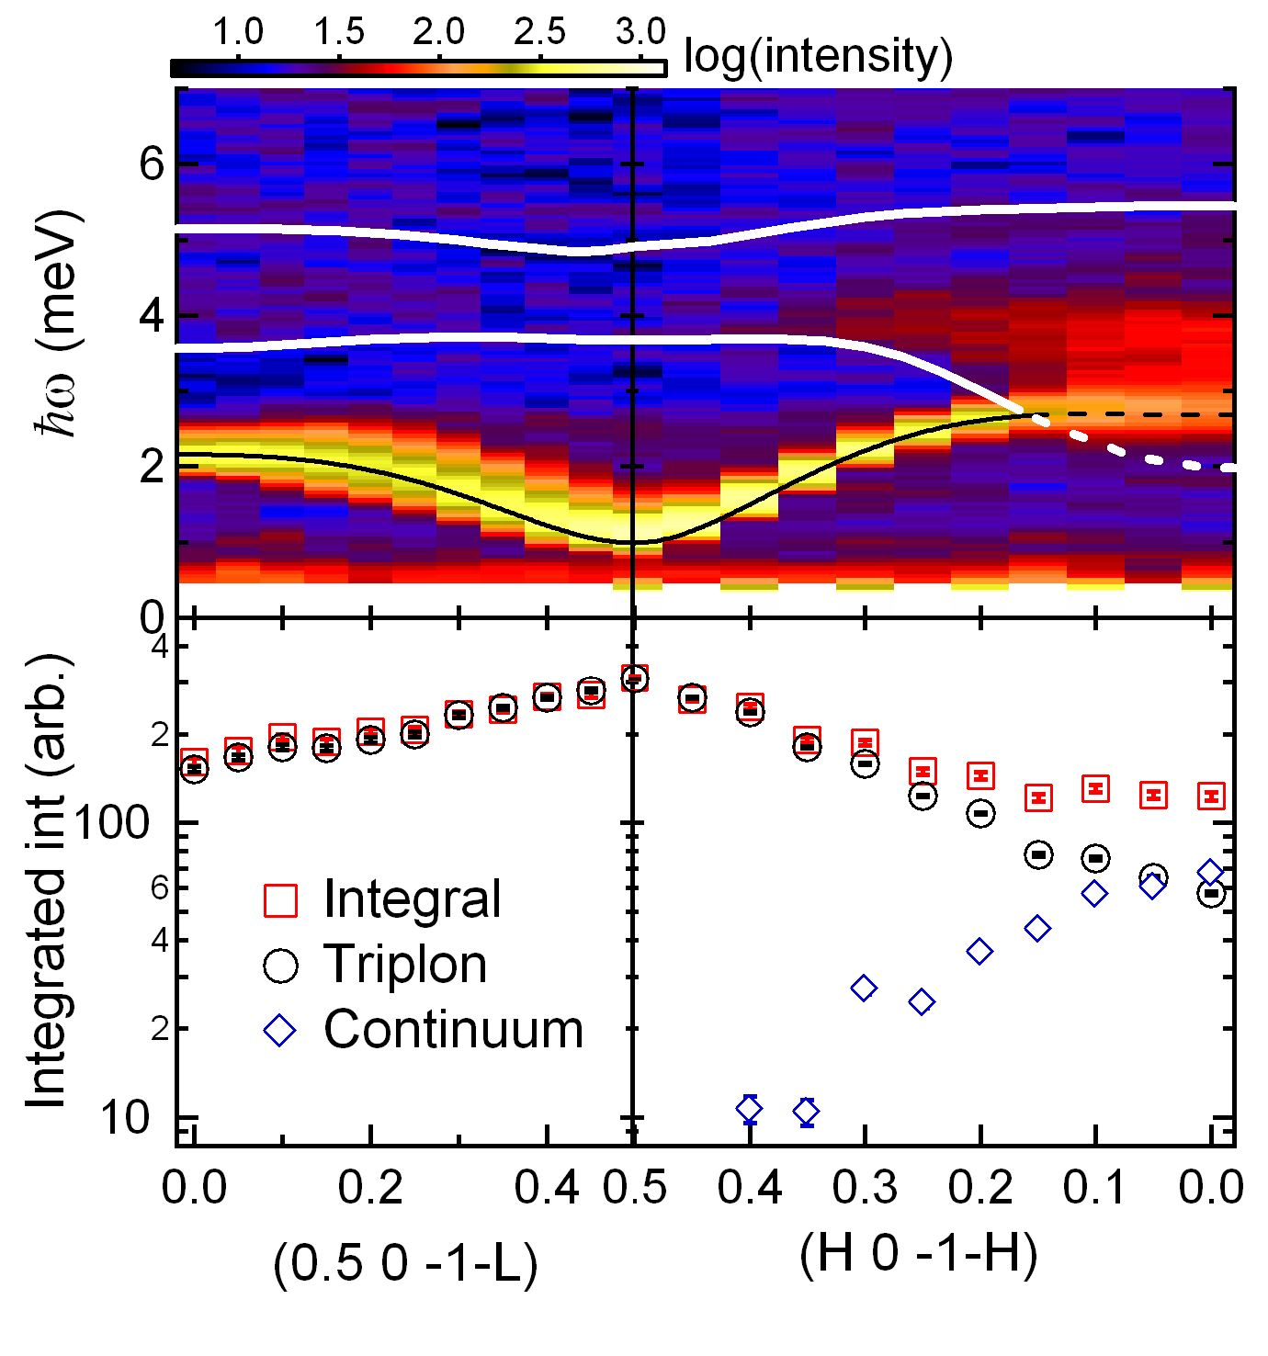
Magnon decay in two-magnon continuum
Stone et al. Nature (2006)
Notes:
By combining more scans of this type we were able to form a complete map of the magnetic scattering cross section shown here along two different direction in reciprocal space. The black line through the sharp mode that dominates the spectrum is our fit to the single magnon dispersion relation. From it we can generate the corresponding lower and upper bounds to the two particle continuum. On the left one sees that the single particle mode fails to meet the inferred continuum and in fact it is difficult to see any spectral weight associated with the continuum there .
However, on the right hand side of the graph the dispersion is stronger and there is a well defined point of intersection between the quasiparticle mode and the lower bound of the corresponding two particle continuum. We worried that the broad higher energy peak might be unhealthy in some way. However, seeing on this figure that the its emergence occurs at the critical vector certainly put much of those worried behind us.

Slide 13
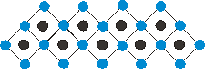
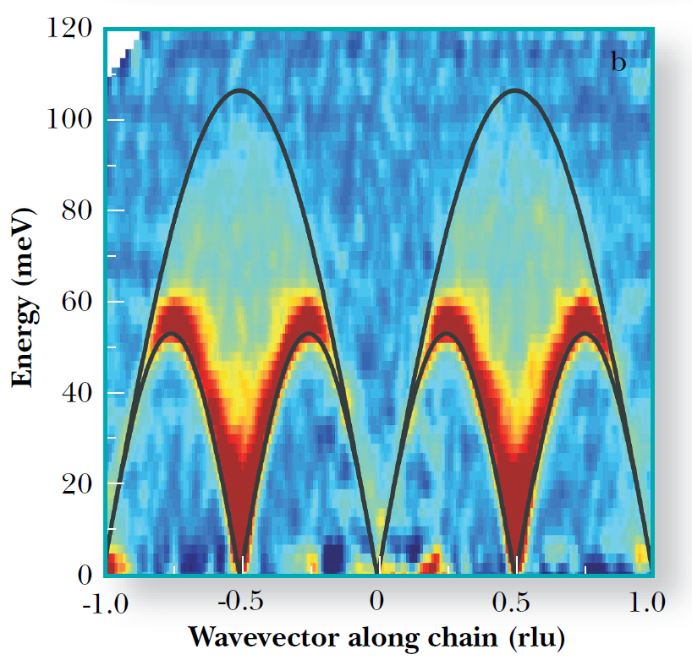
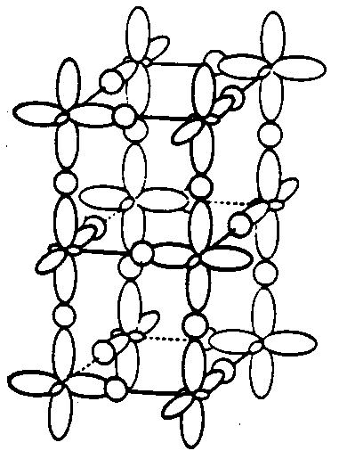
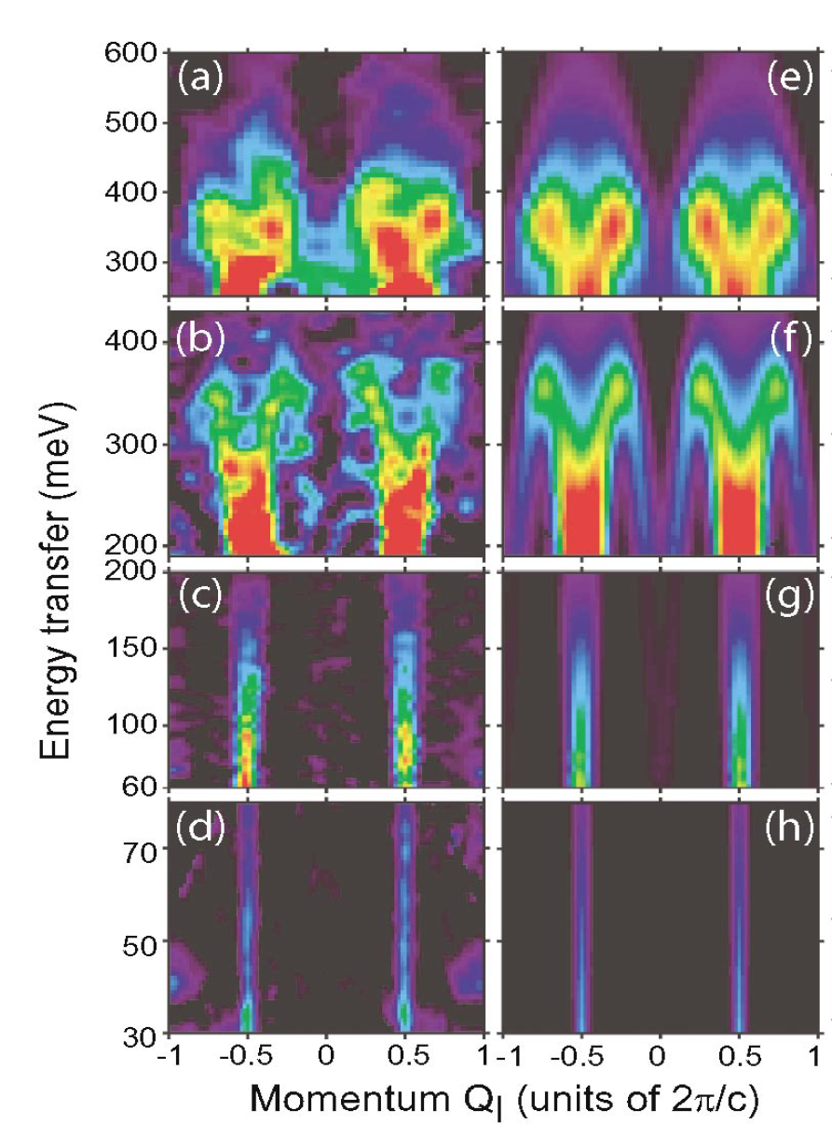
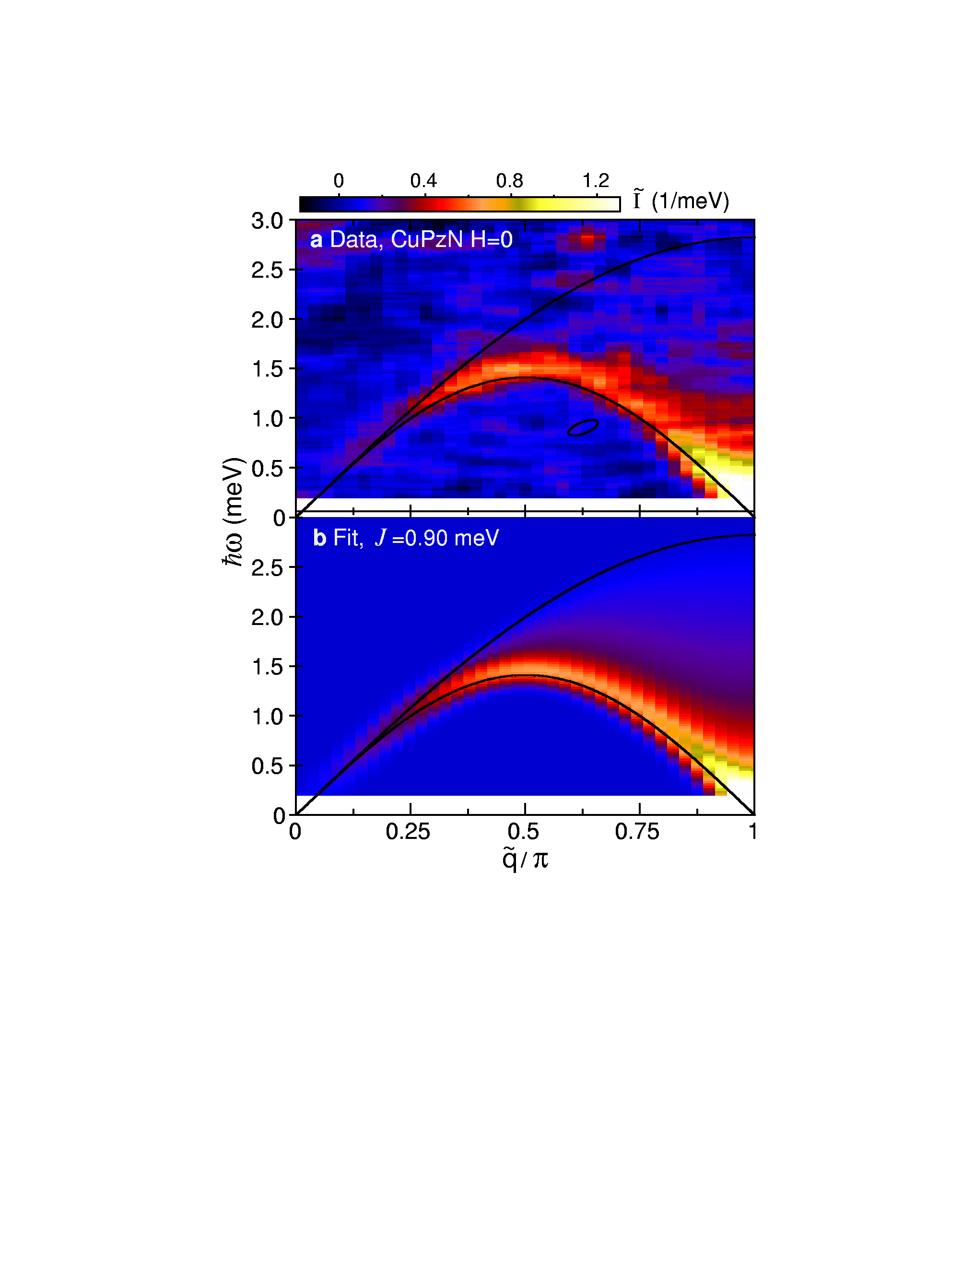
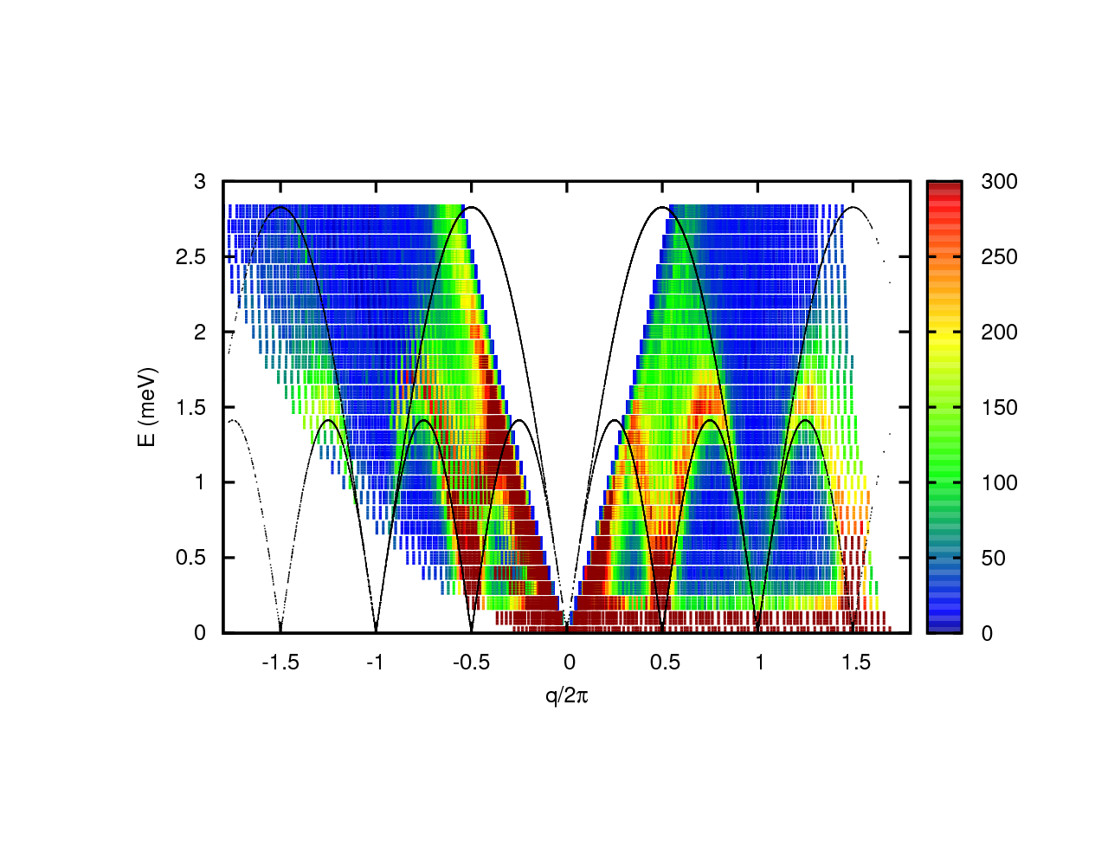
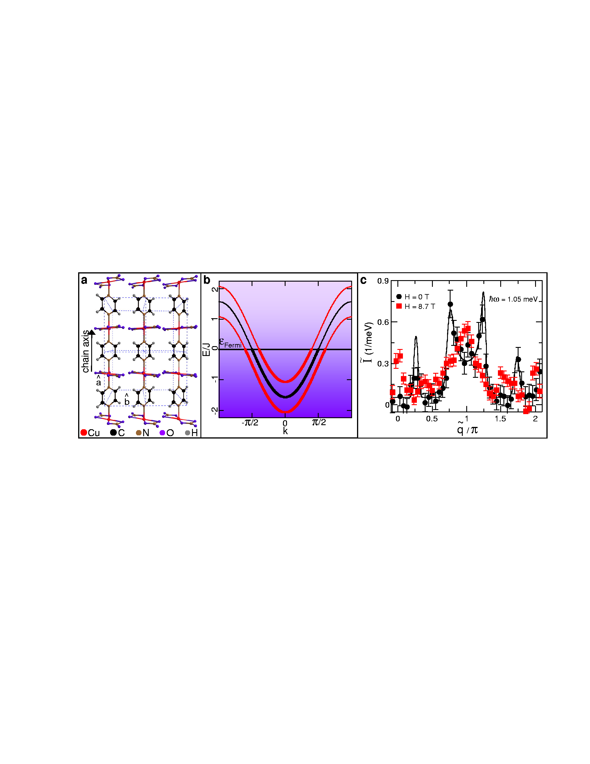
Neutron Scattering from Spin-1/2 chains
KCuF₃: orb. order
Tenant, Lake, Nagler (2005)
SrCuO2: orb. order
CuPzN: Pyrazine
Zaliznyak et al (2004)
Stone et al., PRL (2003)
Notes:
This figure shows magnetic neutron scattering from one dimensional CuPzN versus energy transfer hw and wave vector transfer, Q, along the spin chain.
The most intense spot is at q=pi and hw=0 indicating quasi-static antiferromagnetic correlations.
The intensity generally lies along a ridge that resembles the dispersion for a one-dimensional magnet. However, the bandwidth is renormalized by a factor pi/2 as compared to a classical spin system.
Looking more carefully one finds that the ridge is not resolution limited indicating that the quasi-particles of the spin chain cannot be created individually through neutron scattering.
Now as we are dealing with crystalline condensed matter for T=0 one should expect some form of coherent quasi-particles with a dispersion relation satisfying Blochs theorem.
The solid lines show kinematic boundaries for two particle excitation. All scattering falls between those boundaries so the data is consistent with scattering from a system of quasi-particles that can only be created in pairs.

Slide 14
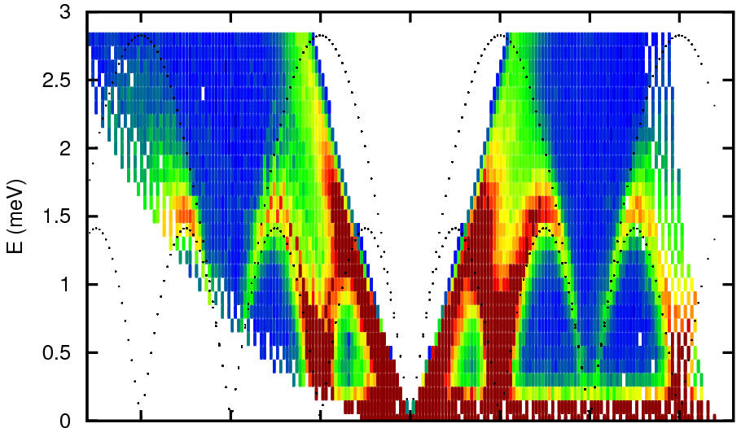
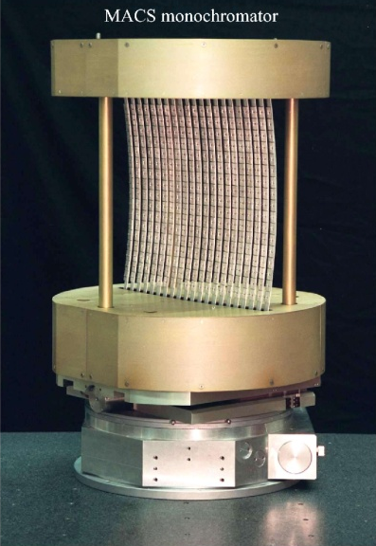
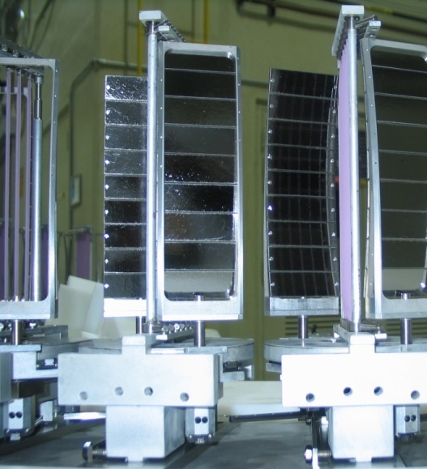
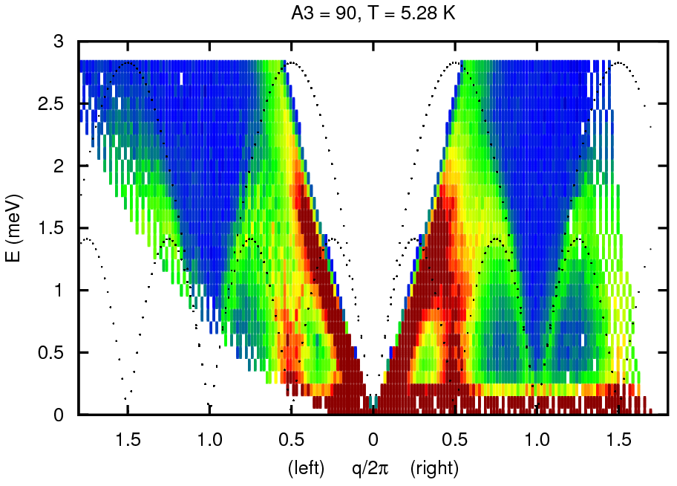
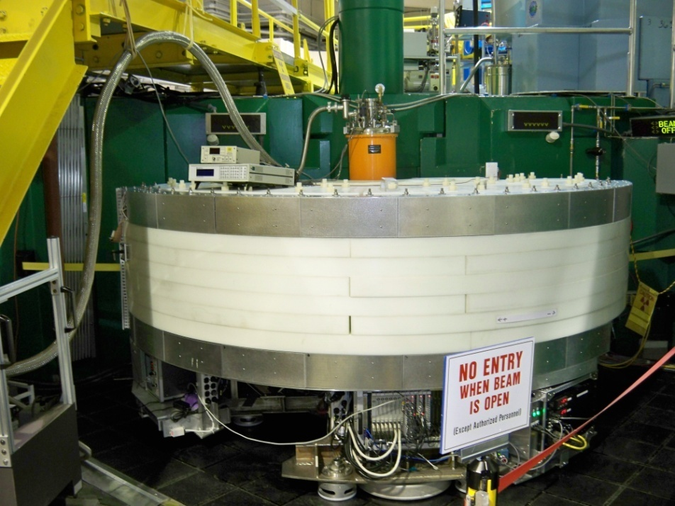
Spinons on MACS
Large monochromator & 20 analyzers
Total of 2.7 hours counting time
T=1.6 K
3.5 hrs
Counting
T=5 K
3.5 hrs
Counting
MACS @ NCNR

Slide 15
Disintegration of a spin flip
Spinon
Spinon
Notes:
Quantum spin chains host unique types of quasi-particles that are the basis for understanding strongly correlated electronic systems. One example are the so-called spinons in infinitely long chains of interacting spin-1/2 dipole moments. Apart from their conceptual importance they may also have applications for highly anisotropic thermally conducting materials.
Spin-1/2 chains have quasi-long range but dynamic antiferromagnetic correlations. The figure illustrates the dissociation of a single spin flip into two spinons that are essentially domain walls between different phase shifted antiferromagnetic domains. In zero and uniform fields the spinons should be non-interacting particles that neutrons create in pairs as they scatter. The consequence should be an unusual two-spinon continuum of neutron scattering in the low temperature limit of a physical system with no disorder. Neutrons scatter from spinons in the same way that they scatter from metals: through quasi-particle quasi-hole pair excitations. The bounded continuum reflects the joint density of states for specified total linear momentum.
Upon application of a uniform field, the spin chain is magnetized through a finite density of magnetized spinons. Equivalently there is a shift in the chemical potential for spinons. The result should be incommensurate gapless continua. The incommensurability reflects the spacing between magnetized defects or equivalently the field dependence of the distance between fermi points resulting from shifting the chemical potential.
Quite different behavior is expected upon application of a staggered field. The staggered field can result from a uniform field when applied to a spin system with alternating orientations of the coordinating environment around spins. Under those circumstances a specific antiferromagntic domain is selected by the staggered field. Consequently two spinons bracketing a “wrong” domain will attract. This is equivalent to the tendency of ferromagnetic domains that are opposed to the applied uniform field to shrink but it is in one dimension and for an antiferromagnet. When spinons attract the result is novel bound states called solitons and their combinations called breathers.

Slide 16
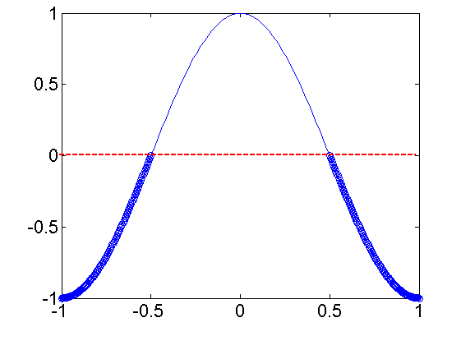
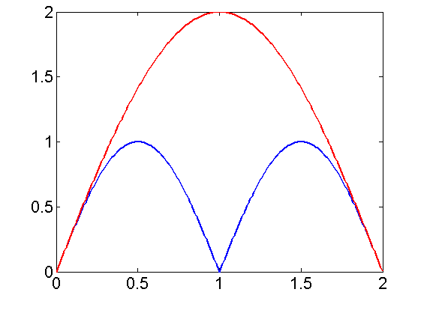
From band-structure to bounded continuum
J
ε/J
ω
h
q (π)
Q (π)
Notes:
These processes can be illustrated through the following graphs. On the left is shown the cosine band structure, on the right is the two dimensional Q-omega plane that maps one dimensional scattering events.
The important thing to notice is that for a given Q there is a range of possible values of energy transfer and hence an energy cut should display a continuum rather than a single sharp excited state.
The most intense point at q=pi and e=0 would for example corresponds to the umklapp process showed in black. At the same wave vector transfer a much higher energy excitation is however also possible. It corresponds to promoting an occupied state from deep within the Fermi sea to the top of the band. And so on.
For the spin-1/2 chain it can be shown that S(qw) factorizes as the product of the quasi-particle density of states and a transition matrix element. For the X-Y case the matrix element is a constant so that the scattering cross section is simply the two spinon joint density of states. However, things are considerably more complex for the Heisenberg case. The matrix element has a square root singularity at the lower threshold of the continuum. 6 years ago an exact closed form expression for the two spinon contribution to S(qw) was derived. We shall compare this result to the experimental data on the next slide.

Slide 17
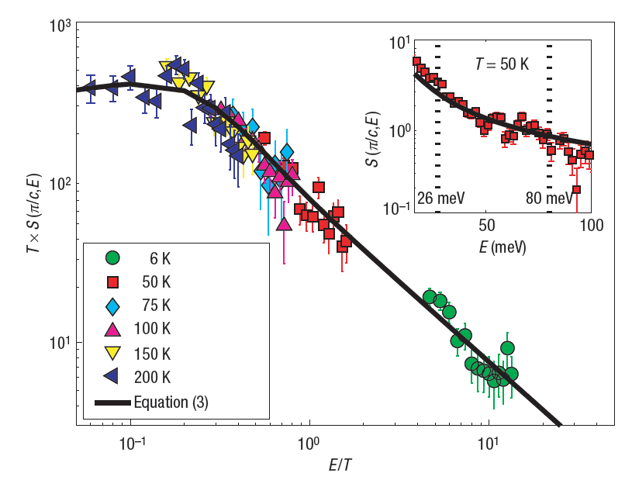
Quantum Criticality: T is only energy scale
Lake et al (2005)
Lake et al (2005)
Notes:
We can get higher statistics data and a more impressive data collapse by integrating over wave vector transfer. The raw data are shown here and they collapse nicely to a tanh curve when plotted as chi versus e/T.

Slide 18
Quantum Critical Spin-1/2 chain
1
2
3
4
5
0
Damle and Huse PRL (2002)
Notes:
One way is through bond alternation as was recently discussed in an elegant paper by Damle and Huse.
Here is a plot of the gap energy versus bond alternation. On the left even bonds are strongest and on the right odd bonds are strongest. In both phases there is a gapped excitation spectrum corresponding to triplons moving coherently along the chain. As they are spin-1 particles triplons can be created individually and in pairs. At the critical point the even and odd bonds have equal strength and the continua and bound states merge into the gapless spinon continuum that we have just described.
One of the consequences of quantum criticality is that temperature is the only relevant energy scale in the long wave length limit.

Slide 19
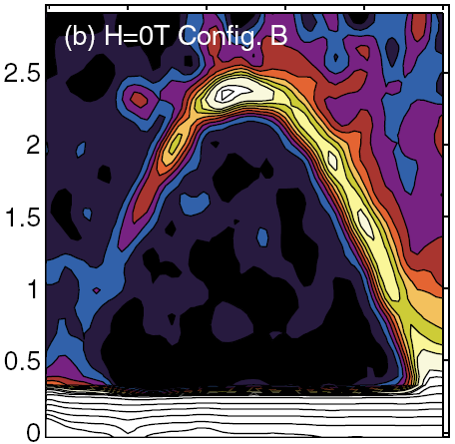
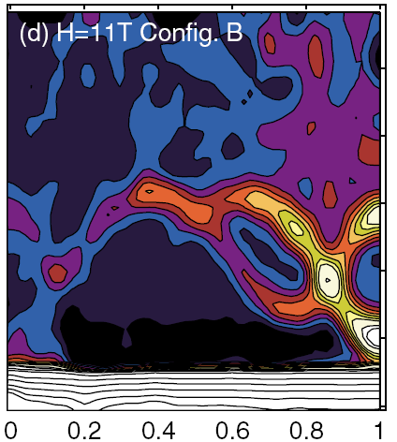
Two & one-particle scattering in spin chains
CuCl₂.2(DMSO):
Spin-1/2 chains in a crystal
Kenzelmann et al. PRL (2004)
Notes:
Case in point is CuCl2DMSO. Magnetism is associated with copper II ions coupled to form an ensemble of independent spin chains.
Each spin seeks singlet formation with its neighbor but failing to break right left symmetry the system remains in a critical state.
The gapless continuum indicates that neutrons interact with spin chains through a two particle process as expected for a quantum critical spin system.
The clearest indication however of criticality is the high sensitivity to perturbations. So lets apply a high magnetic field to the sample. The field experienced by the CuII ion actually depends on the coordinating surroundings and since that rotates from site to site the uniform field actually is modulated or staggered along the spin chain.
The effect of this perturbation is dramatic. While a continuum remains at the highest energies, Much of the spectral weight has collected into sharp resonant modes.
Hence the application of a site modulated magnetic field has the effect of changing the dominant scattering process from two to a one particle scattering.

Slide 20
Why staggered field yields bound states
Zero field state quasi-long range AFM order
Without staggered field distant spinons don’t interact
With staggered field solitons separate “good” from “bad”
domains, which leads to interactions and “soliton” bound state
Notes:
A staggered field should have a major qualitative impact on the spin chain. This can be traced to the fact that it is a spatial symmetry breaking field. At the microscopic level the mechanism is as follows:
Without a staggered field there are two degenerate spin configurations that differ from each other by a phase shift of pi.
Spinon’s are boundaries between these different spin configurations. As a result of the degeneracy distant spinons don’t interact hence the gapless continuum.
However, the staggered field favors one domain over the other so that spinons become boundaries between domains with different energies. The result is long range forces between spinons which form bound states. Thus what used to be a two particle continuum becomes distinct resonant modes of excitations.

Slide 21
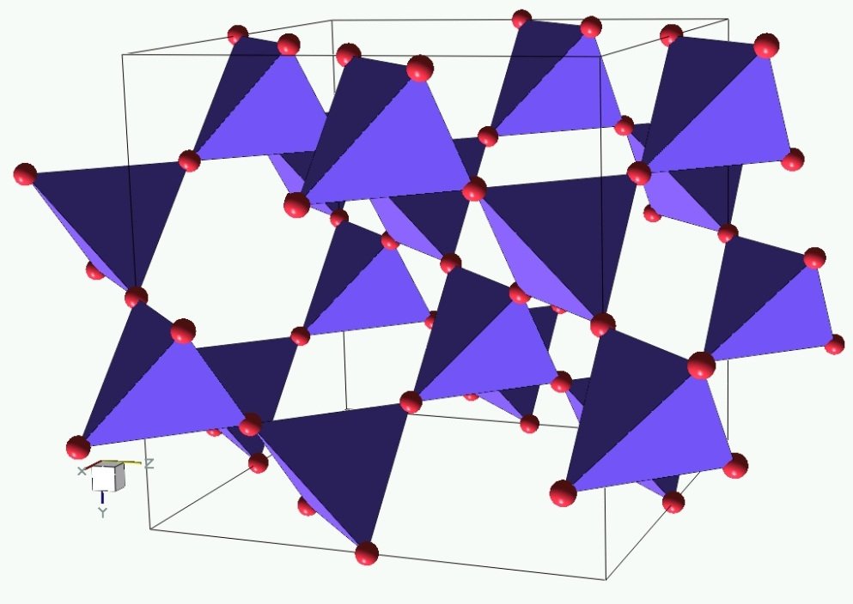
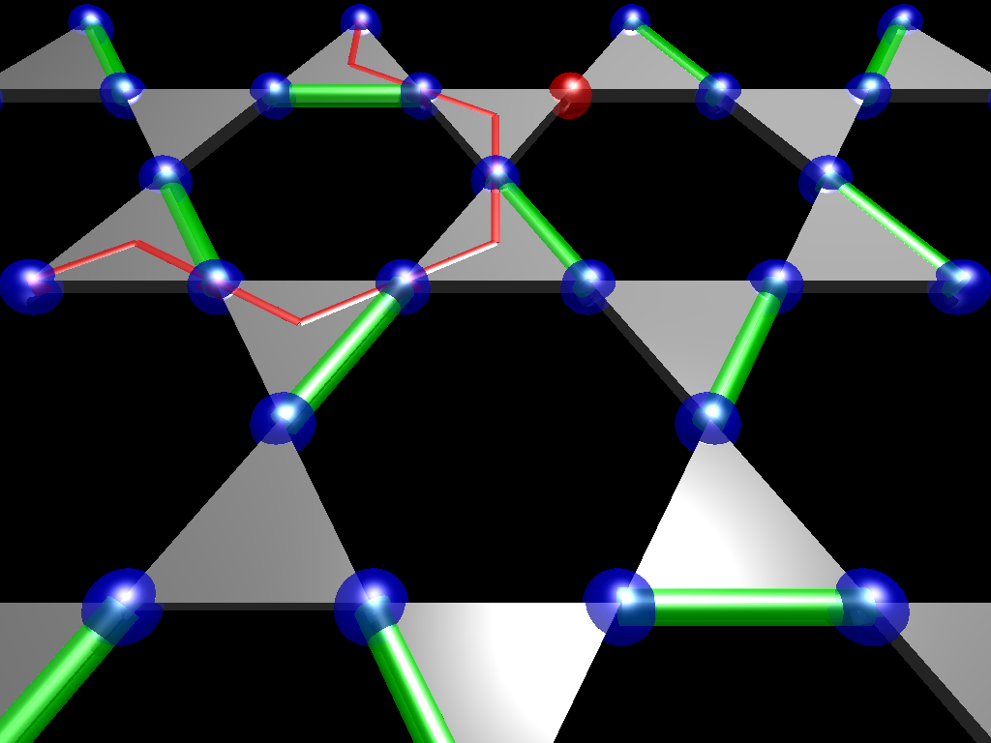
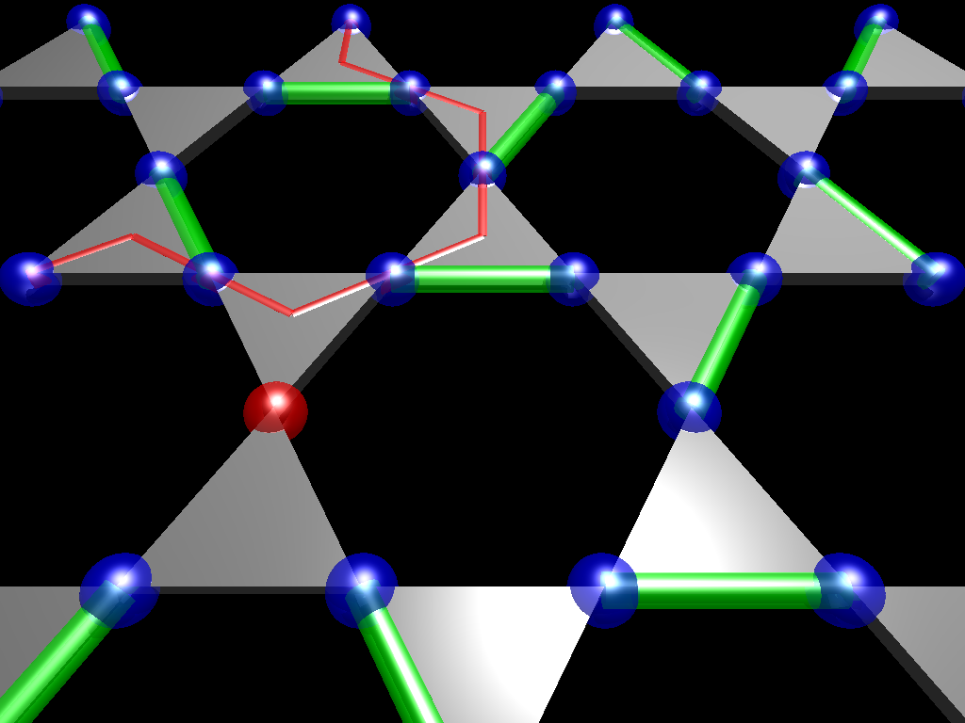
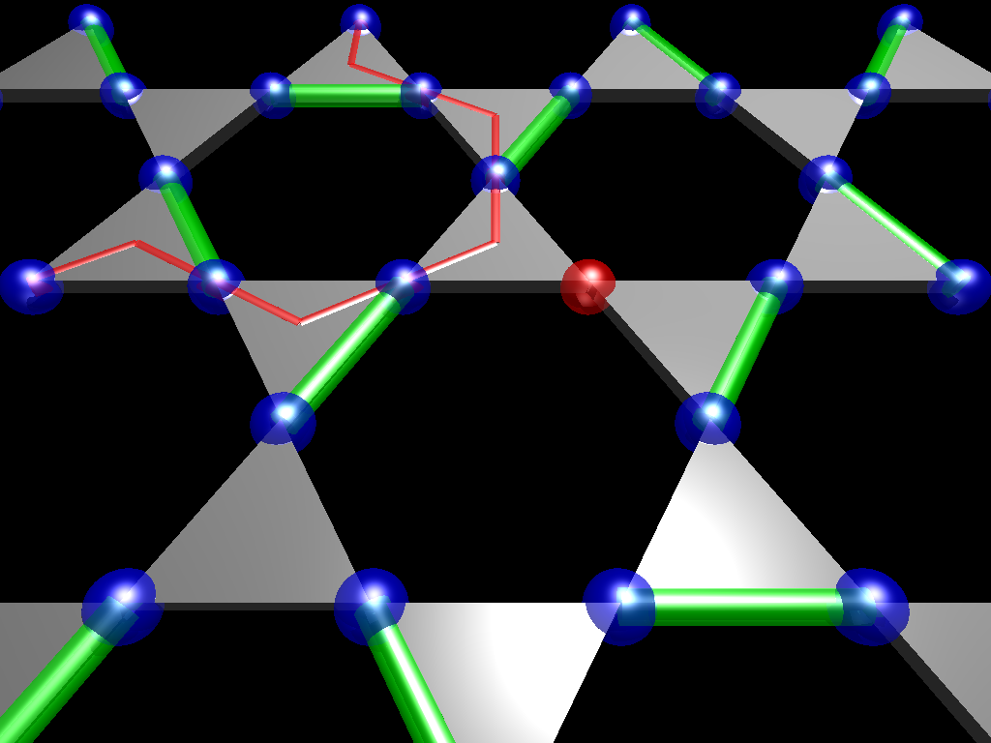
Quantum Magnetism from Frustration
Corner-sharing
tetrahedra
Hao & Tchernyshyov (2009)
Frustration &
weak connectivity
stunt growth of correlations
Triangular
Kagome
Quantum Magnetism
Notes:
There are two high symmetry options: edge sharing and corner-sharing triangles. We shall hear more about both of these lattices through the conference. Here I want to focus on the triangular lattice.

Slide 22

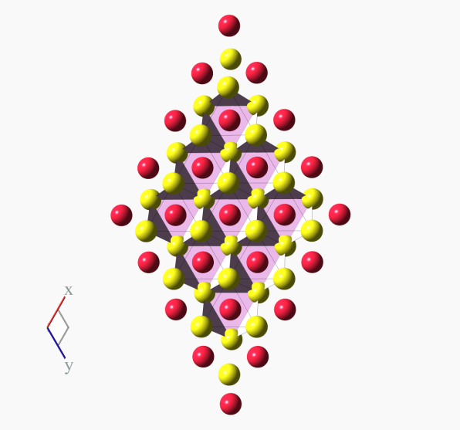
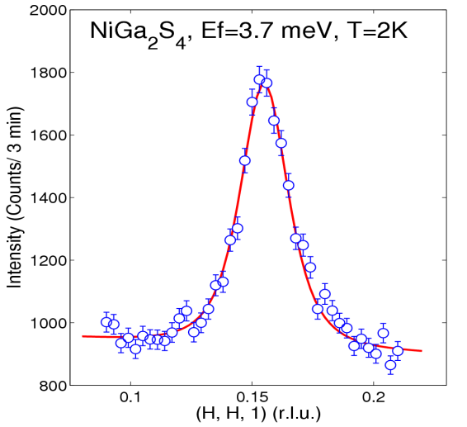
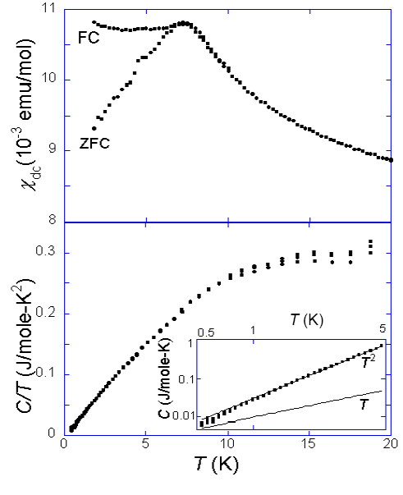
Frustrating outcomes
Lattice distorts Long range order
Weak disorder Spin freezing
ZnCr₂O₄
Stock et al. (2009)
NiGa₂S₄
40 K
15 K
1.5 K
S. H. Lee et al. (2000)
Nakatsuji et al (2006)

Slide 23
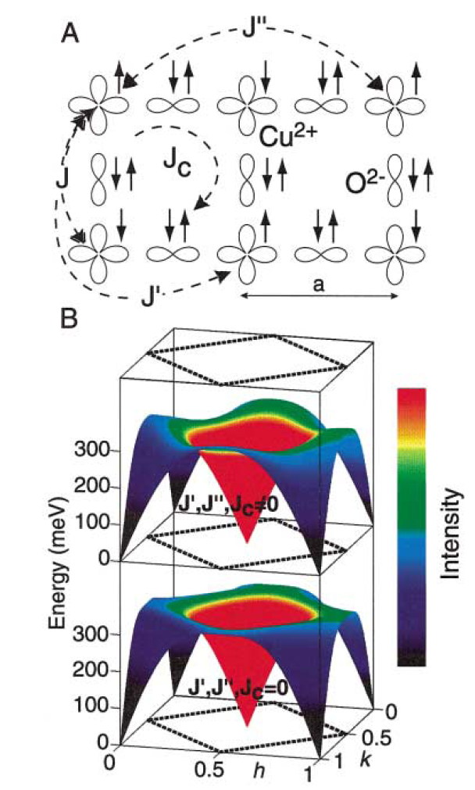
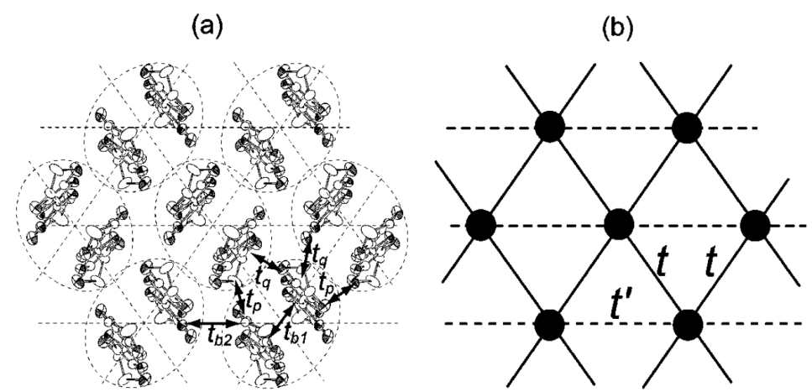
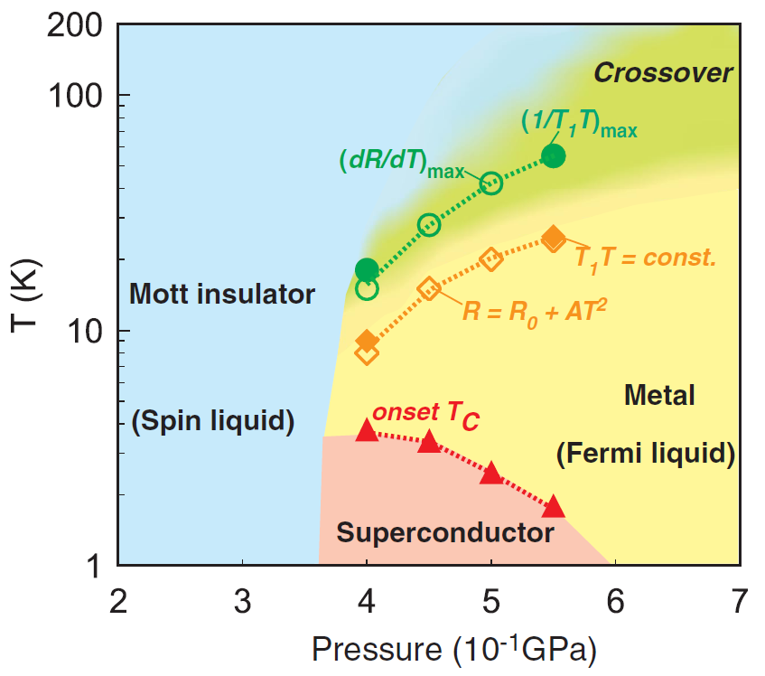
Frustration + Fermions = spin liquid
La₂CuO₄ Coldea et al 2001
κ-ET₂Cu₂CN₃ Kurosaki et al (2005)

Slide 24
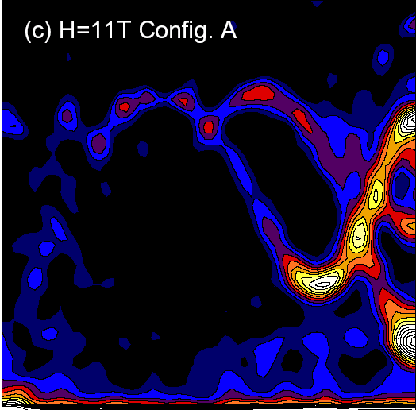
Summary
Quantum magnetism: beyond spin to collective quantum correlations
Stabilized by
  Low dimensionality
  Frustration
  Proximity to metal insulator transition
Examples
  Spin dimers: Propagating triplet excitons
  2-magnon continuum and magnon decay
  Spinons and quantum criticality in spin-1/2 chain
  Spin-liquids beyond one dimension?
Accelerated progress from new instruments
Notes:
Staggered fields are ubiquitous for low symmetry spin chain systems and have pronounced effects on the physical properties.
By breaking the sublattice degeneracy a staggered field causes spinon binding so that the low energy field theory is the quantum sine gordon model.
By measuring the ratio of the breather and soliton mass versus coupling strength, we have confirmed the experimental relevance of this theoretical result. We also compared with and found excellent agreement with structure factor calculations for the breathers.
This work establishes the spin-1/2 chain in a staggered field as an outstanding experimental realization of the important QSG Model.
And overall this work provides an example of a relatively simple model, where theoretical and experimental work correlates to a remarkable degree in describing complex cooperative properties.
I am hoping that with new and more efficient neutron sources and with the growing wisdom of Amnon and his students, the future will bring similar detailed understanding of cooperative properties in two and three dimensional strongly correlated systems.
Happy Birthday Amnon and thank you all for your attention.

