Slide 1

Five neutron experiments that advanced hard condensed matter
Collin Broholm
Johns Hopkins University
Notes:
I know many of you but I was surprised to learn of the secret retreats in rural Virginia. Thanks to Thiyaga for organizing this event and indeed for inviting me to speak bright and early on day 1.

Slide 2
Caveats !!!
Not authoritative, representative, or balanced
Based on things I know & like
Conducive to concluding remarks
To make the list
  Introduce or confirm a new paradigm
  Enabled by instrumental innovation
  Author should preferably not be at this meeting

Slide 3
Overview
Introduction
Five great experiments
  Neel Order
  Phonons
  Soft modes
  Quantum Magnetism
  Structure of Oxides
Lessons learned
Notes:
I would like to make this an overview of our new organization the Johns Hopkins-Princeton Institute for Quantum Matter and some of the science that we have been working on these past 2 year.
After an introduction to our goals and techniques there are distinct but linked sections on iron superconductivity and frustrated magnetism.
I shall end with conclusions and some thoughts about the future.

Slide 4
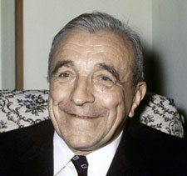
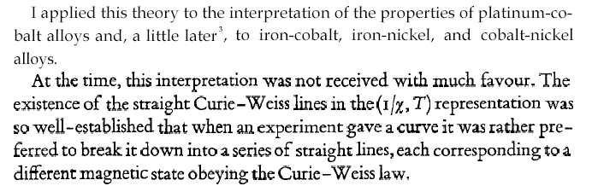
A brief story of Antiferromangetism
1970 Nobel Prize in Physics to
Hannes Alfvén and Louis Néel
L. Néel 1904-2000
Nobel lecture (1970).
Notes:
Neel who had worked extensively on understanding ferromagnetism and ferrimagnetism within mean field theory in 1935 suggested an analogous description of antiferromagnetism in which magnetization develops in opposite directions on two different sublattice. The small effect in uniform susceptibility measurements resulting in this description from a macroscopic cancellation of the moments on the two sub-lattices. As Neel mentions here in his Nobel lecture, the suggestion was initially not well received by the establishment.

Slide 5
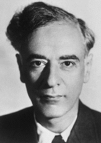
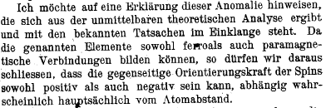
Staggered magnetization or QM singlet
1962 Nobel Prize in Physics
L. D. Landau 1908-1968
Phys. Zs. UdSSR (1933).
Notes:
Landau had a different understanding of what type of state might result from antiferromagnetically interacting spins. Not well documented in the literature but see that he thought of AF interactions as inducing a quantum paramagnet where spins are fluctuating but in opposition so there is no time averaged magnetization on any site. I illustrate his vision of AFM by fluctuating arrows.

Slide 6
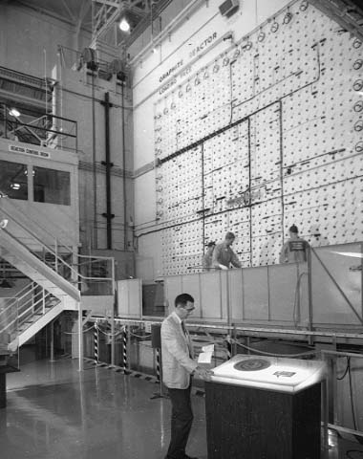
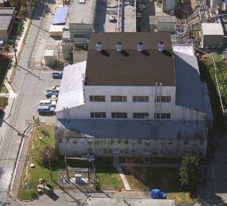
Early Graphite Reactor Days at ORNL
Wollan set up double crystal spectrometer in November 1945
First powder pattern, rocksalt, in April, 1946
Shull joined Wollan in August, 1946
Wally Koehler (1949), Mike Wilkinson (1950)

Slide 7
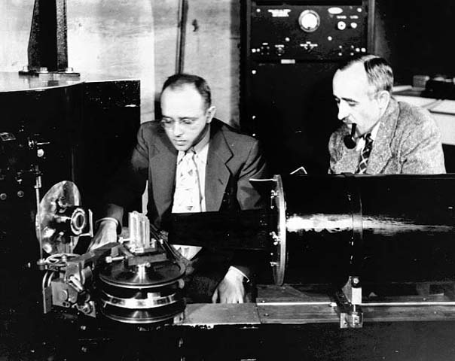
Development of Neutron Diffraction
Clifford Shull and Ernest Wollan: pioneers of neutron diffraction with their ORNL machine.

Slide 8
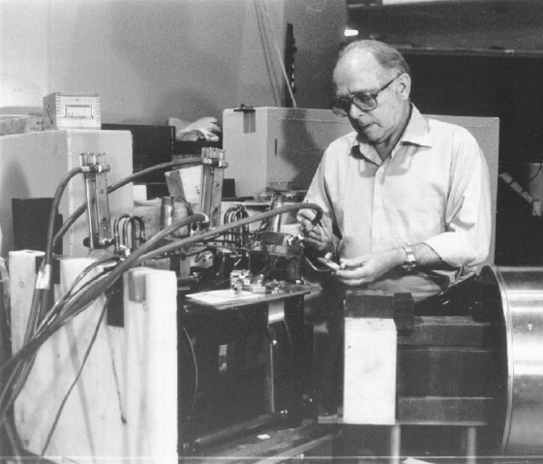
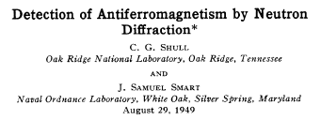
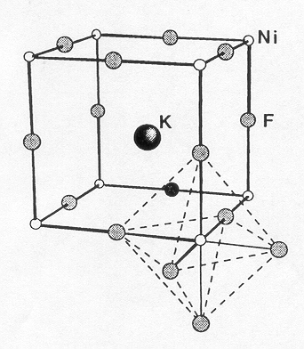
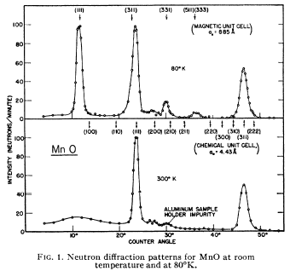
Experimental Evidence for Néel order
C. G. Shull 1915-2001
1994 Nobel Prize to B. N. Brockhouse and C. G. Shull
Notes:
Neel was vindicated when elastic neutron diffraction experiments by Shull and co-workers showed the reality of sublattice magnetization in insulating antiferromagnets through magnetic neutron diffraction.
The chart shows magnetic powder neutron diffraction data above and below the magnetic ordering temperature that is now called the Neel temperature. The appearance of new peaks in between the nuclear Bragg peaks is indication of doubling of the unit cell as predicted by Neel. The corresponding antiferromagnetic structure is shown in this sketch. In this state there is a time averaged magnetic moment on all sites of the lattice though the spatial average of magnetization cancels at the macroscopic length scale.

Slide 9
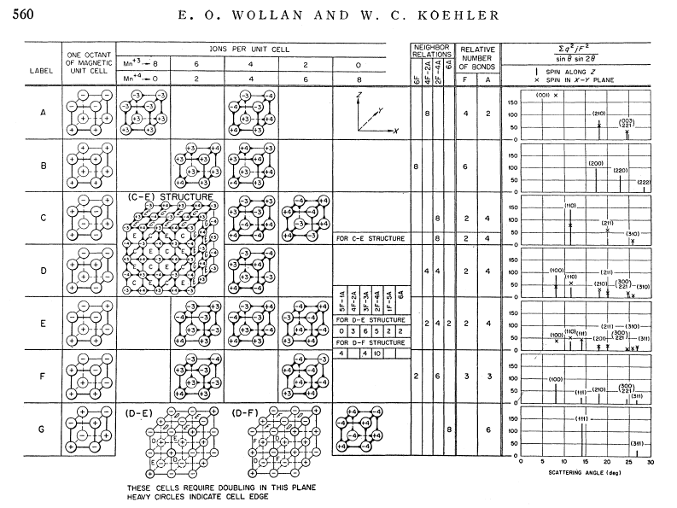
Early Classification of AFM ordering
C. G. Shull and J. S. Smart, Detection of antiferromagnetism by neutron diffraction, Phys. Rev. 76, 1256-1257 (1949).
C. G. Shull, W. A. Strauser, and E. O. Wollan, Neutron diffraction by paramagnetic and antiferromagnetic substances, Phys. Rev. 83, 333-345 (1951)

Slide 10
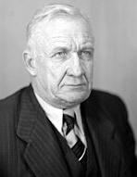
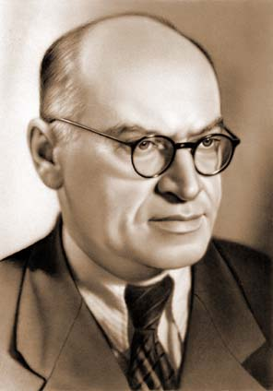
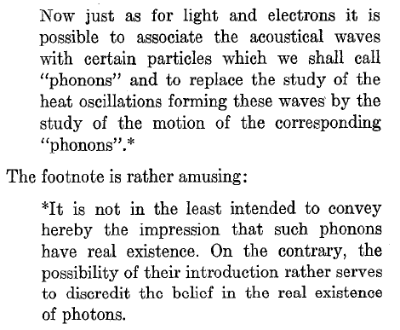
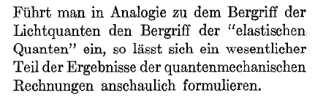
Phonons: concept and/or reality?
Tamm, Russian Physicist
1895-1971
1958 Nobel Laurate
Y. Frenkel, Russian Physicist
1894-1952

Slide 11
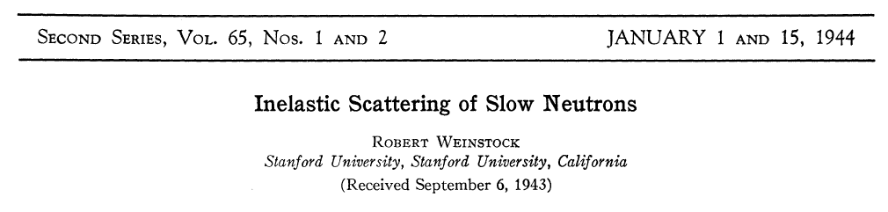
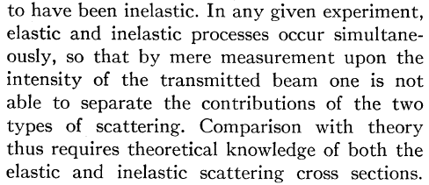
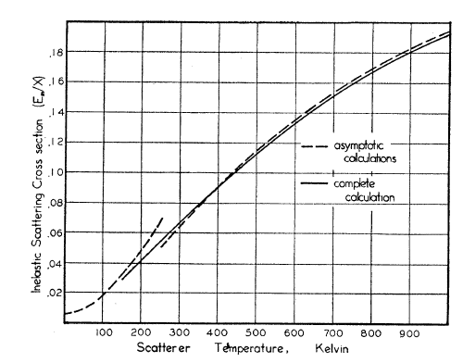
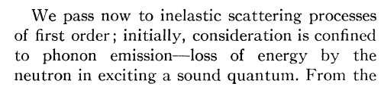
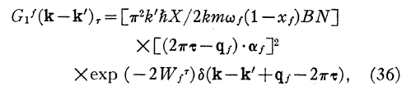

Slide 12
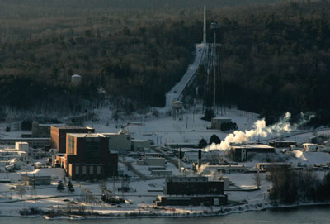
Meanwhile at Chalk River
NRX Reactor
NRU Reactor

Slide 13
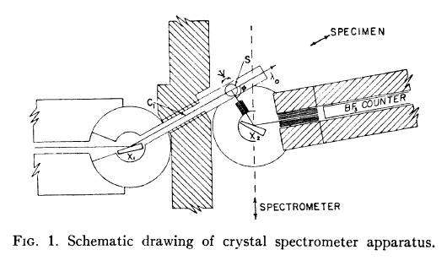
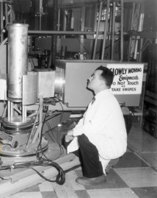
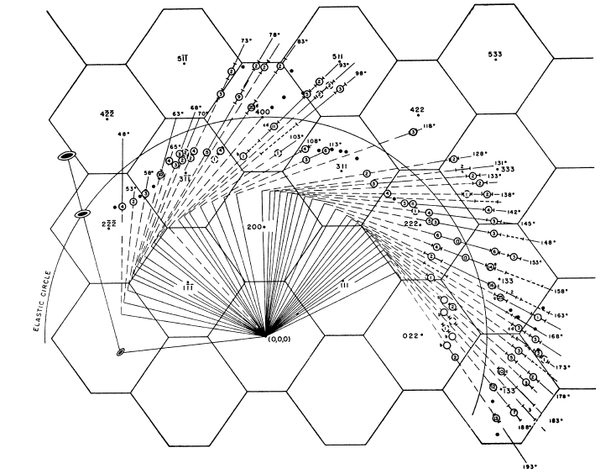
Invention of the Triple Axis Spectrometer
B. N. Brockhouse 1957
Nobel Prize 1994

Slide 14
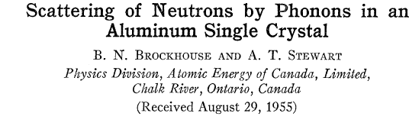
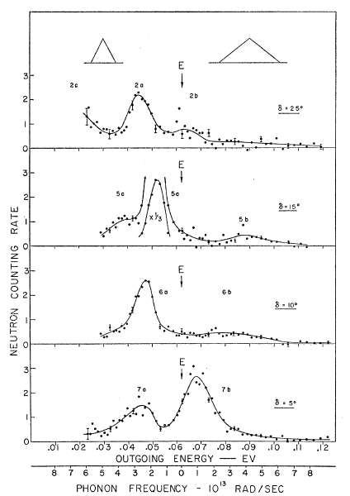
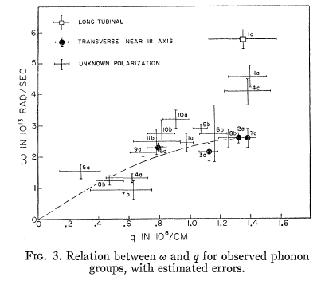

Slide 15
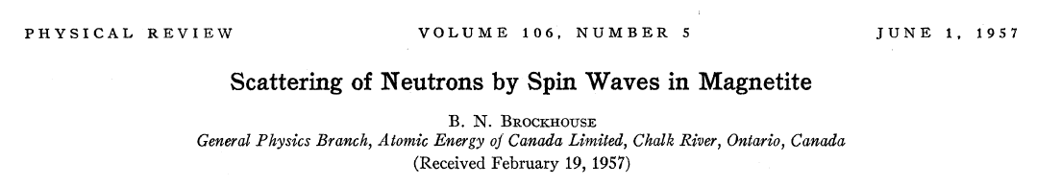
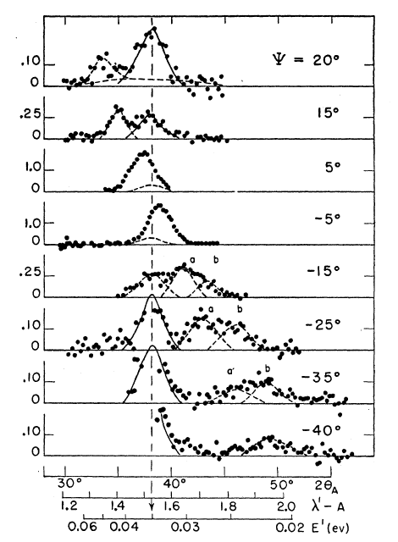
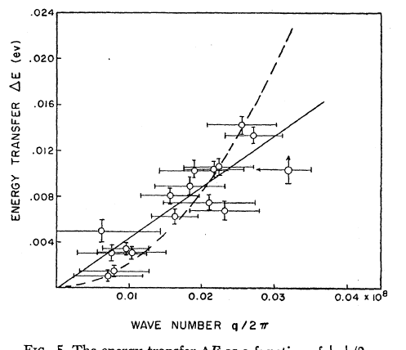
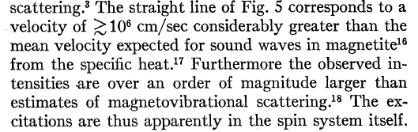

Slide 16
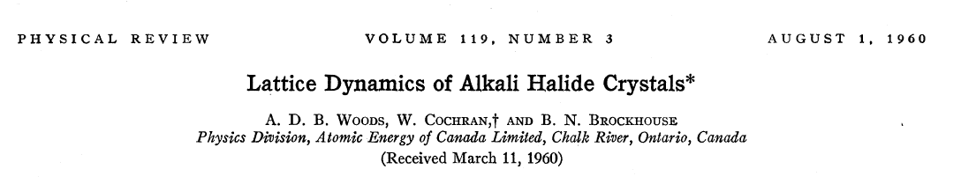
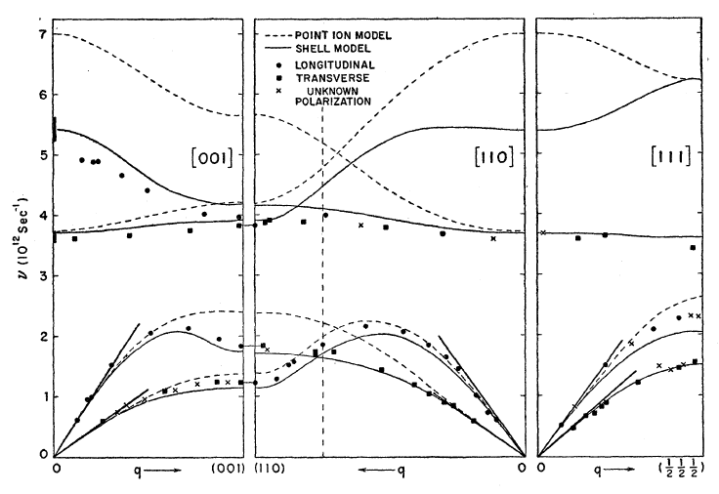

Slide 17
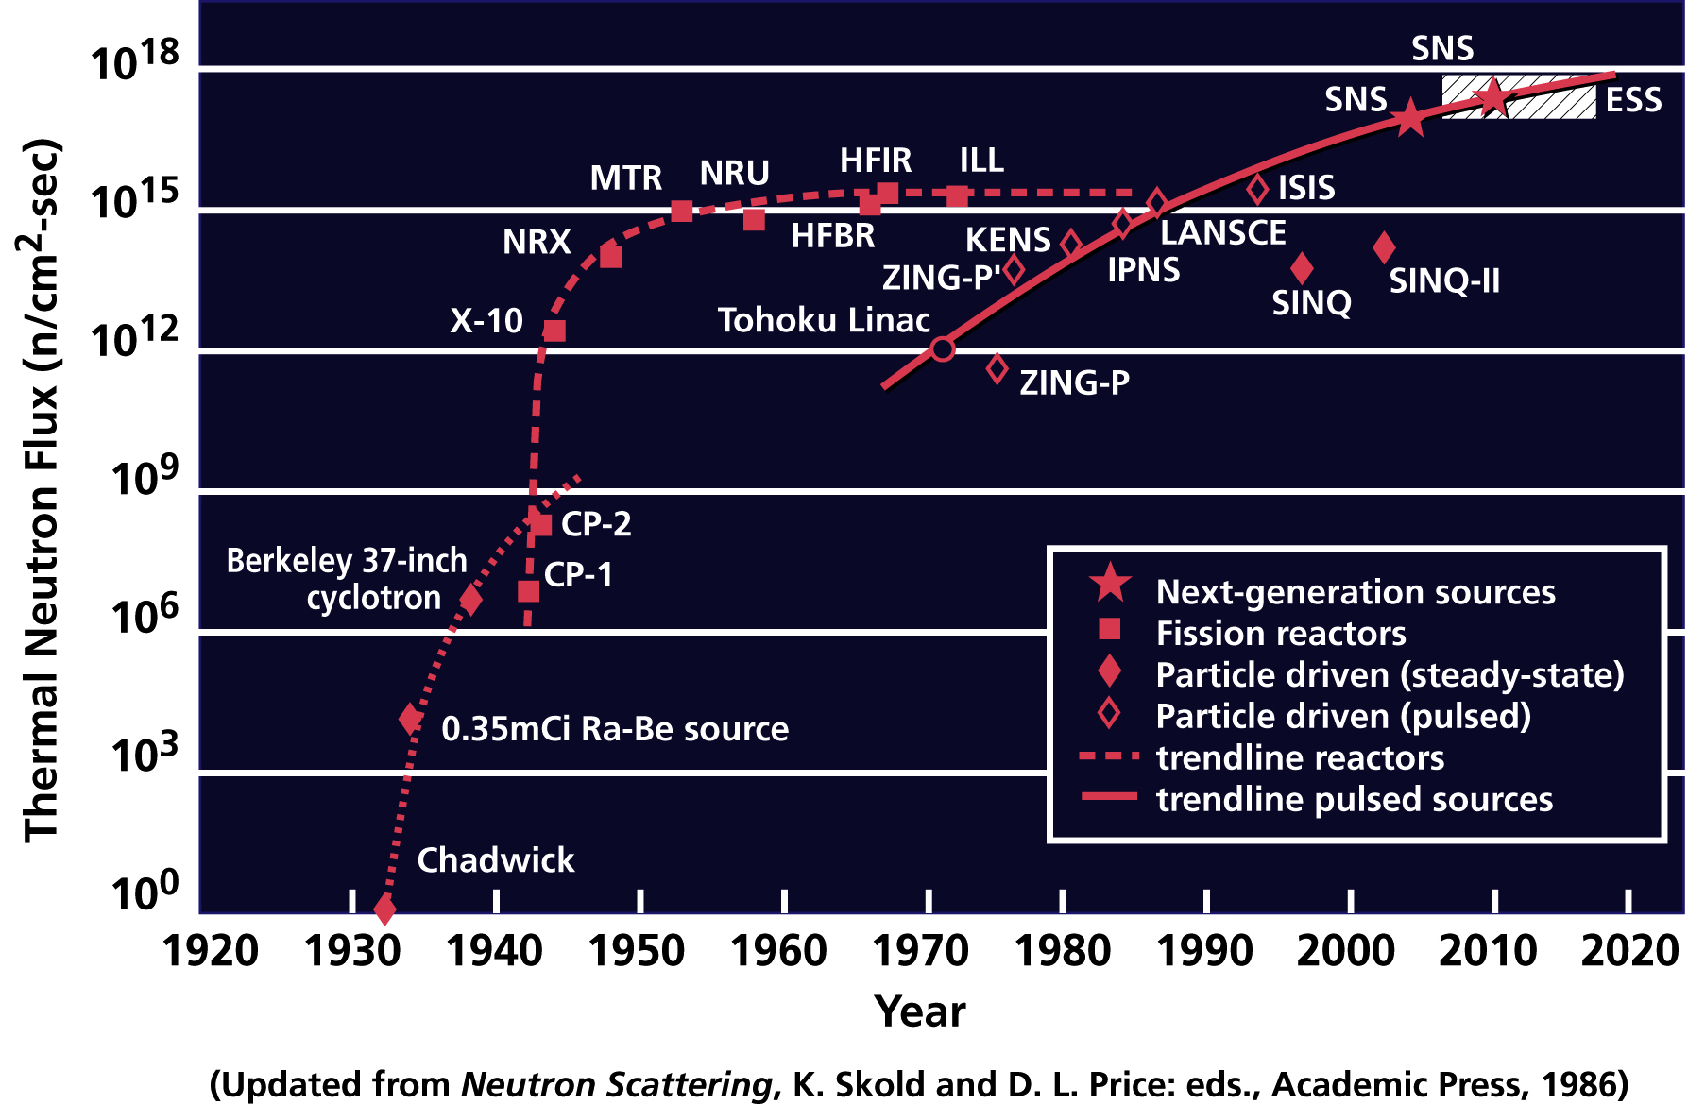
Reactors built for scattering

Slide 18
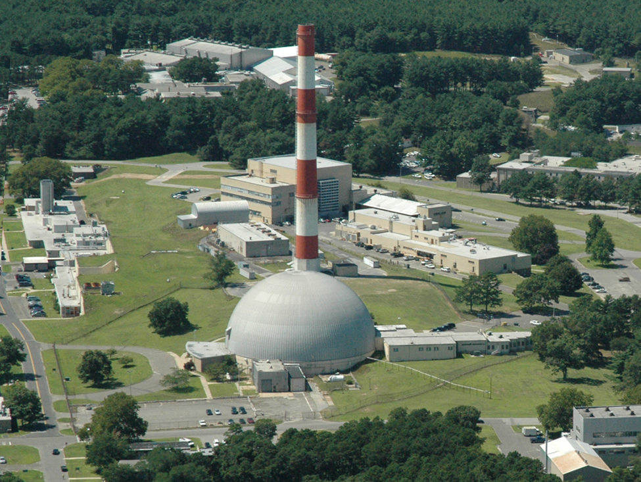
A next Generation of Neutron Source
High Flux Beam Reactor, BNL 1965-1996

Slide 19
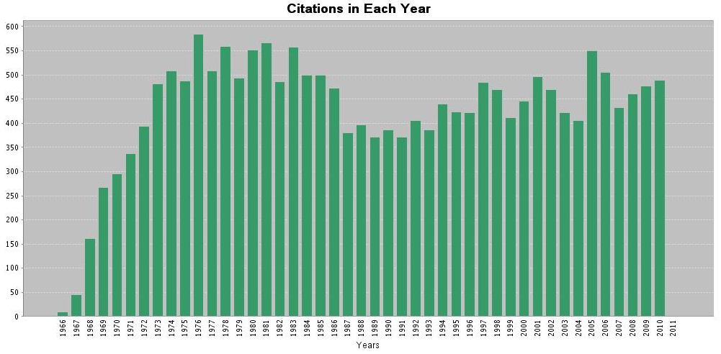
Critical Phenomena burst onto the stage
Citations to papers on “critical phenomena”
Sixties: Scaling theory L. P. Kadanoff and M. E. Fisher
Seventies: Renormalization group by K. G. Wilson.

Slide 20
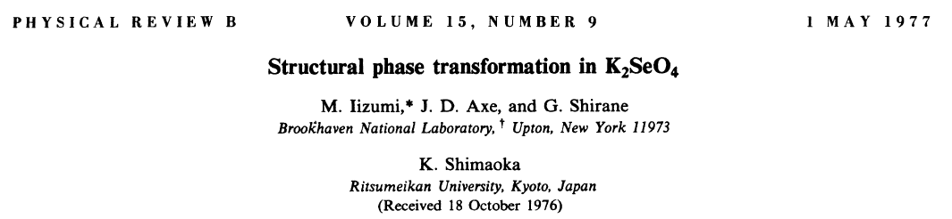
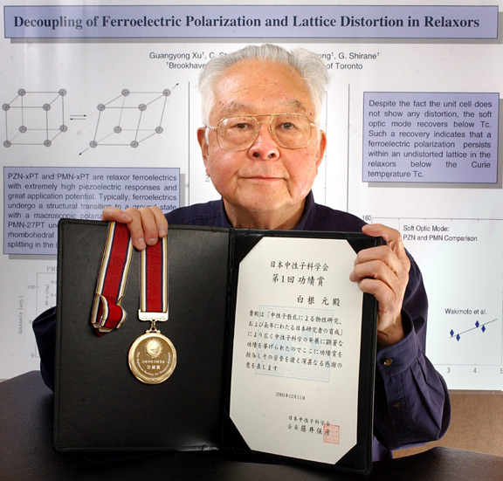
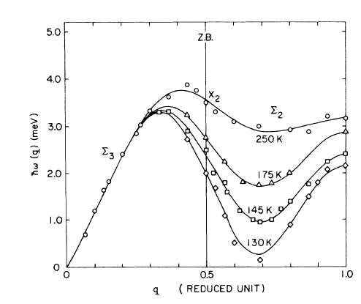
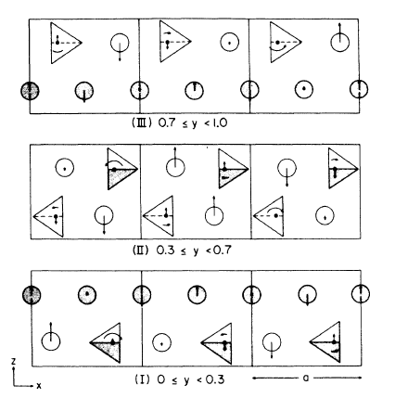
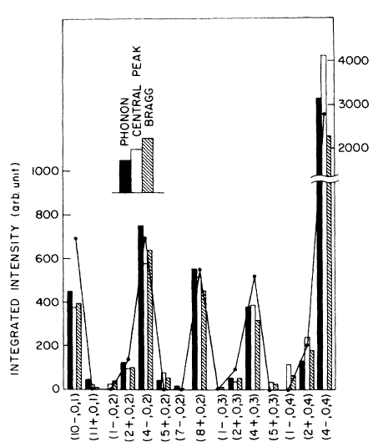
Soft Modes & Phase Transitions
Gen Shirane 1924-2005

Slide 21
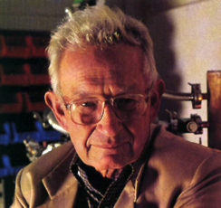
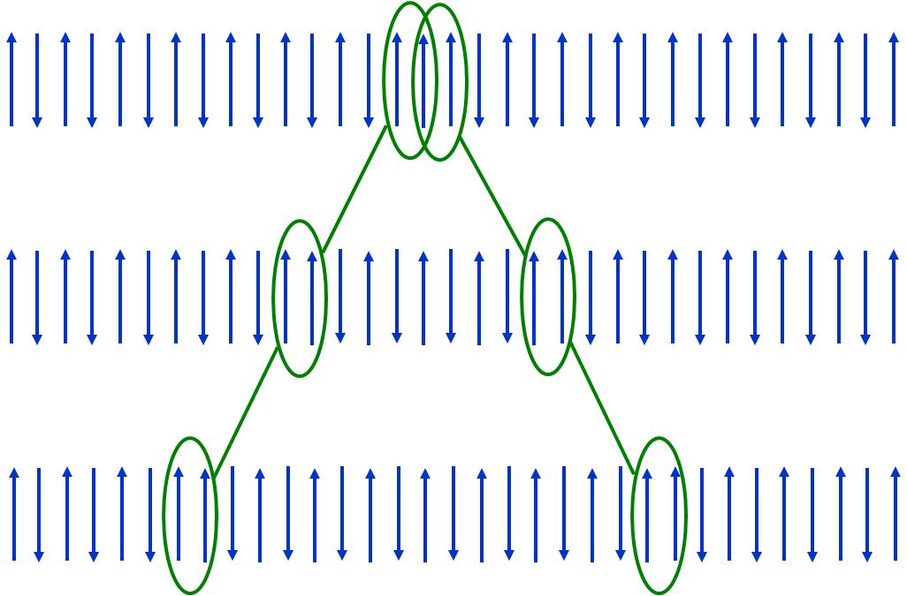
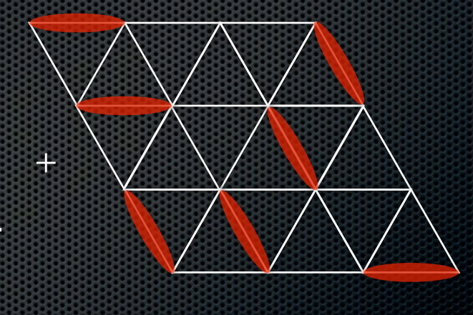
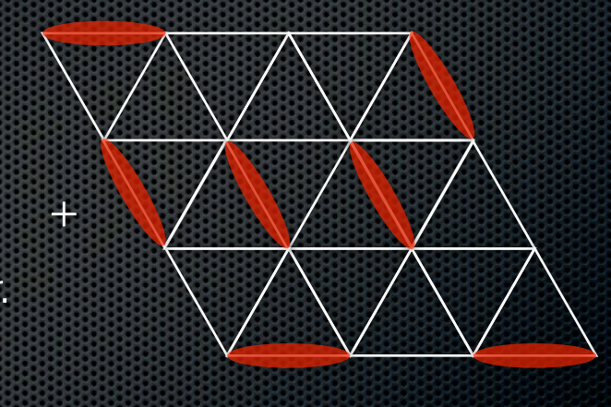
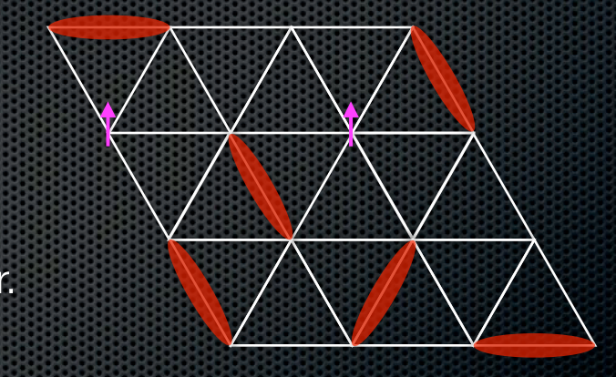
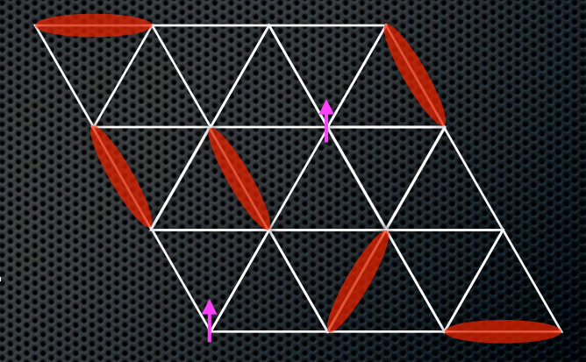
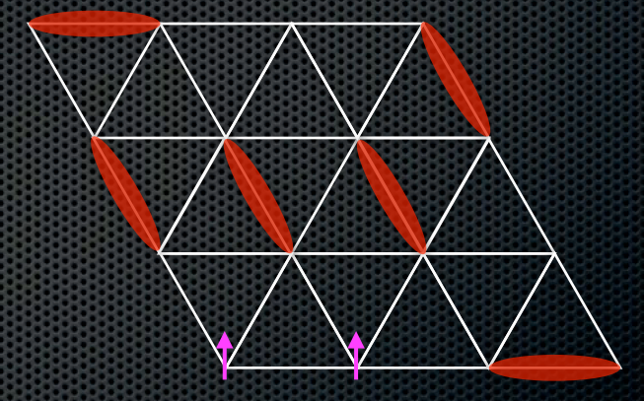
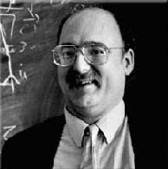
Low D Quantum Magnetism
“What is the spin of a spin wave?” Faddeev and Takhtajan (1981)
“The RVB State in LaCu₂O₄ & Supercond.” Anderson (1987)
“Inter Spin chains & the
O(3) Non Linear Sigma Model”,
Haldane (1983)

Slide 22


Quasi-one-dimensional materials
Spin-1/2 AFM
Spin-1 AFM
KCuF₃
CsNiCl₃

Slide 23

Time of flight inelastic magnetic scattering
MARI spectrometer at ISIS

Slide 24




Slide 25




Slide 26


Time of Flight Powder Diffraction
Jorgensen 1948-2006

Slide 27


Structure of High T_{C} Superconductors
T=623 ºC
J. D. Jorgensen et al PRB
Received June 1987
>1000 citations
T=818 ºC
Notes:
Here are neutron diffraction data from the high Tc superconductors. Because of the exquisite interaction with light atom oxygen accurate information about these atoms positions can only be achieved through neutron diffractions.
Looking carefully at the figure see that the coordination on oxygen sites that coordinate off plane copper changes from six fold to four fold as the material goes orthorhobic from tetragonal. This effect is essential for understanding the doping mechanism in the material.
The paper was published very shortly after the discovery of YBCO and with more than 1000 citation it is one of the most highly cited powder neutron diffraction papers.

Slide 28







Stripes in High T_{C} Superconductors
Tranquada et al. Nature (1995) >1000 citations

Slide 29
Summary
Major impacts from neutrons often associated with
  Theoretical maturity of subject
  Chemistry, new materials
  Advances in instrumentation
New instrumentation at SNS
  Orders of magnitude increase in performance
Our Challenge: Can we identify and exploit
new areas of science ripe for impact from scattering?

