Slide 1

Magnetism Exposed
- an Evolving View from Scattering
Collin Broholm
Johns Hopkins Institute for Quantum Matter
NIST Center for Neutron Research
A Colloquium in honor of Prof. M. Steiner June 3, 2009

Slide 2



Outline
Magnetic Order:
  Ferromagnet
  Antiferromagnet
Fluctuations
  Small Amplitude
  Large Amplitude
Quantum Magnetism
  Intra-Atomic
  Inter-Atomic
Quantum Criticality
  How achieve it?
  Why achieve it?
Conclusions & Outlook

Slide 3
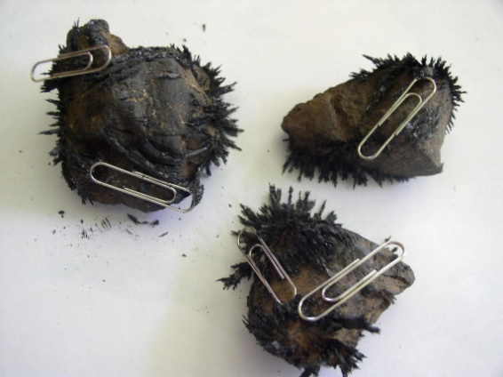

Slide 4
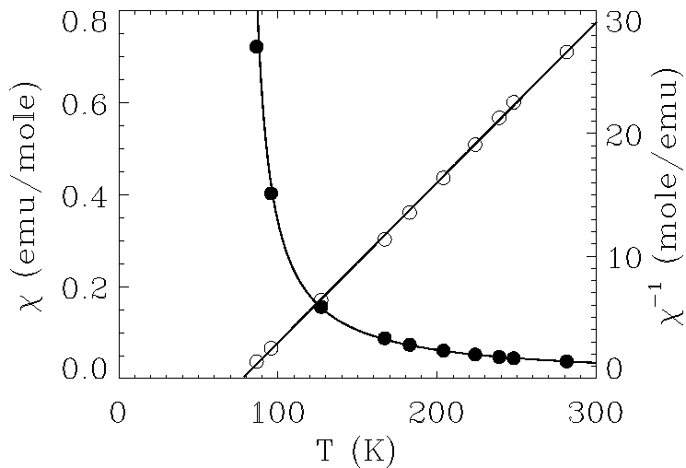
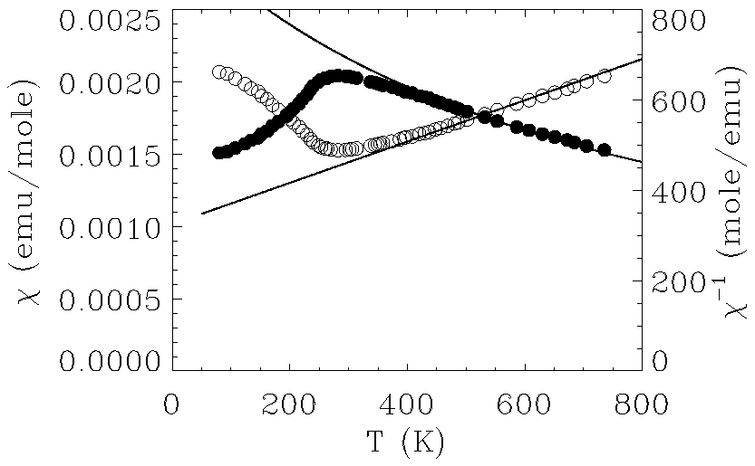
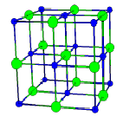
Spin Order: Two of a Kind?
Ferromagnetic EuO
Antiferromagnetic KNiF3
?

Slide 5
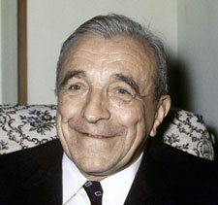
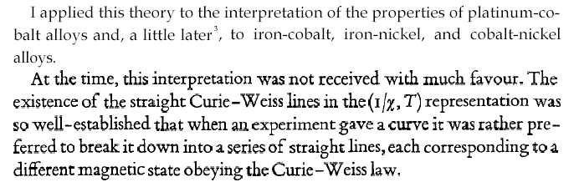
Néel’s proposal: Antiferromagnetism
1970 Nobel Prize in Physics to
Hannes Alfvén and Louis Néel
L. Néel 1904-2000
L. Néel From Nobel lecture (1970).

Slide 6
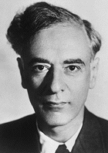
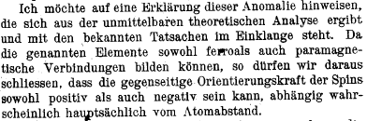
Landau’s Concern: What about the singlet
1962 Nobel Prize in Physics
L. D. Landau 1908-1968
L. D. Landau from Phys. Zs. UdSSR (1933).

Slide 7
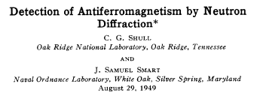
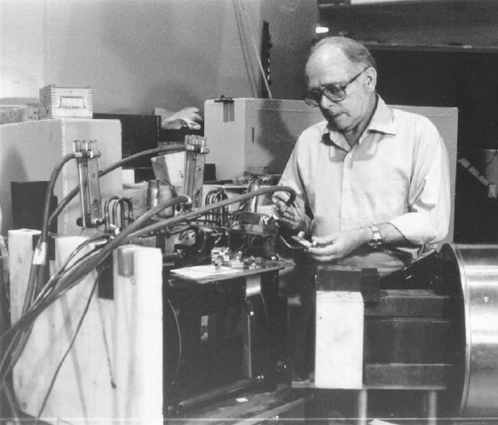
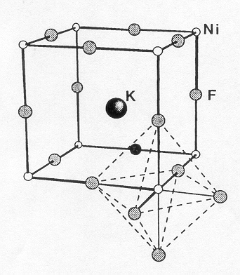
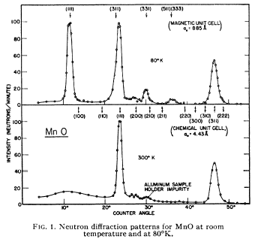
Experimental Evidence for Neel Order
C. G. Shull 1915-2001
1994 Nobel Prize in Physics to
B. N. Brockhouse and C. G. Shull

Slide 8
Is Landau’s vision of an AFM possible?

Slide 9
A Phase Diagram for Quantum Magnetism?
Chakravarty, Halperin, Nelson
Sachdev
T/J
1/S, frustration, 1/z, H, P, x, ...

Slide 10
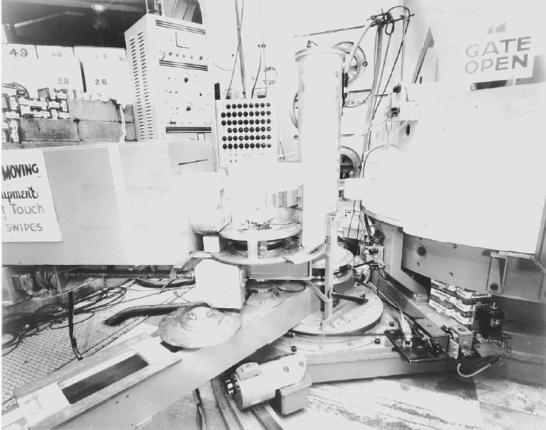
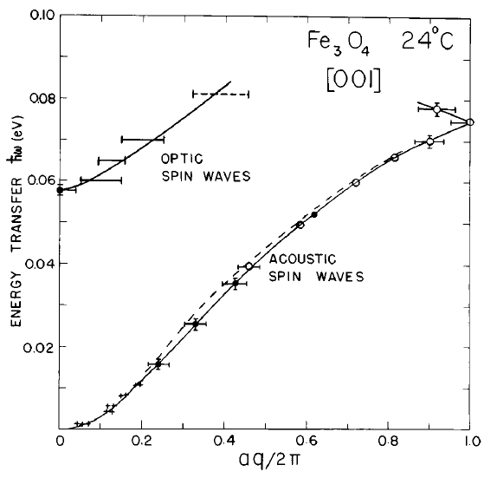
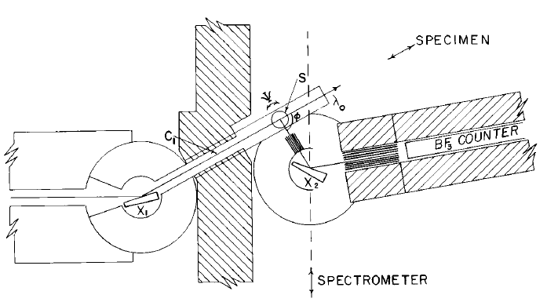
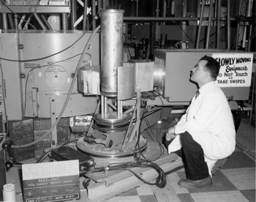
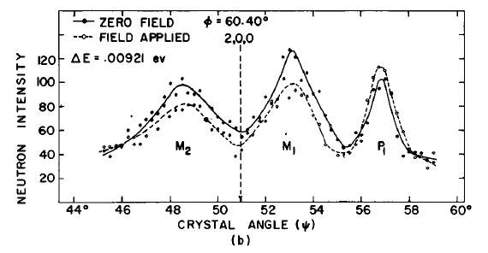
Inelastic Neutron Scattering & magnons

Slide 11
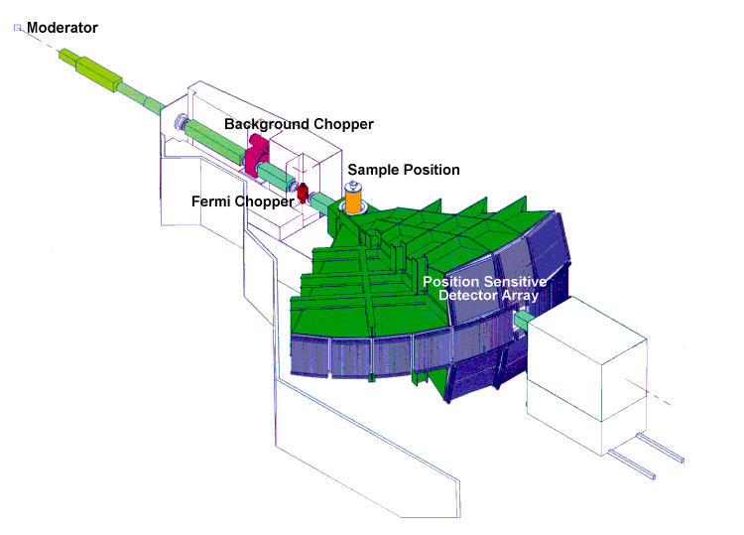
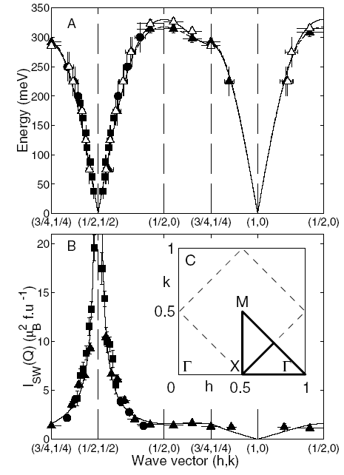

Spin-waves: a slight twist on order
La₂CuO₄
La₂CuO₄
Coldea et al. PRL (2001)
From A. Zheludev’s web page

Slide 12
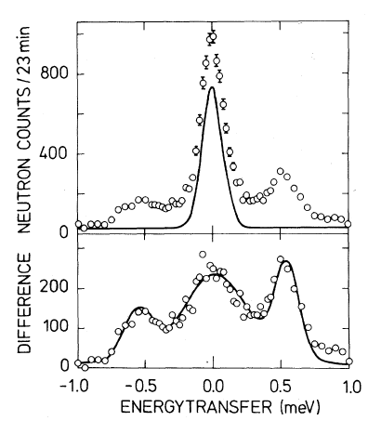
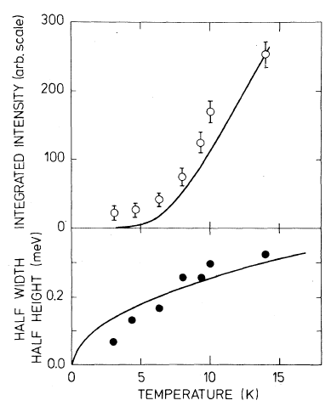
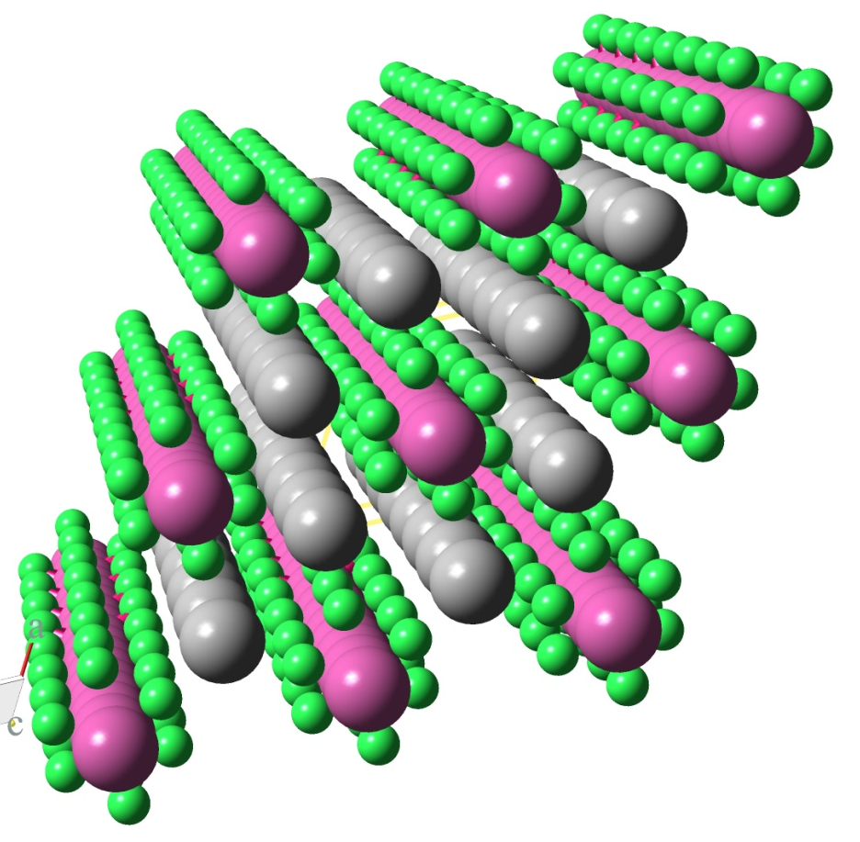
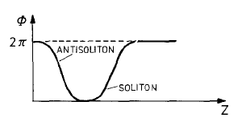
Solitons in CsNiF3: Twisting by 2π
Kjems & Steiner
(1978)
Kjems & Steiner (1978)

Slide 13
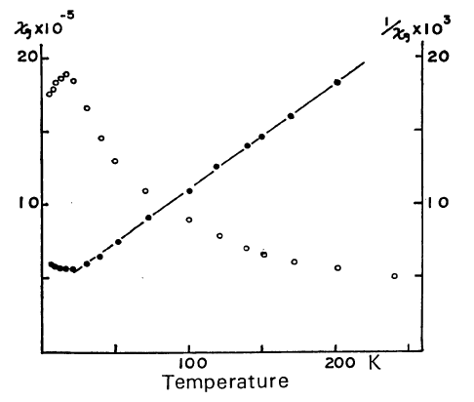

Intra Atomic Singlet Ground State?
CsFeBr3
A
Spin-1 easy plane antiferromagnet

Slide 14

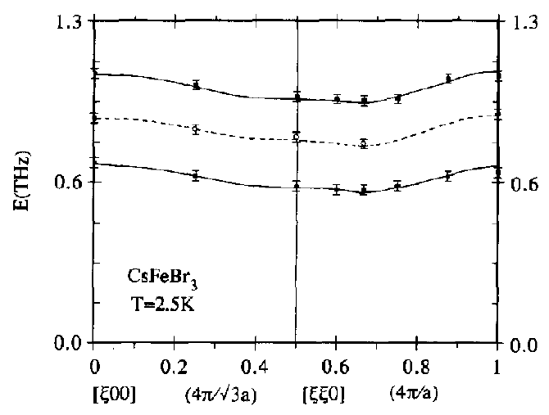
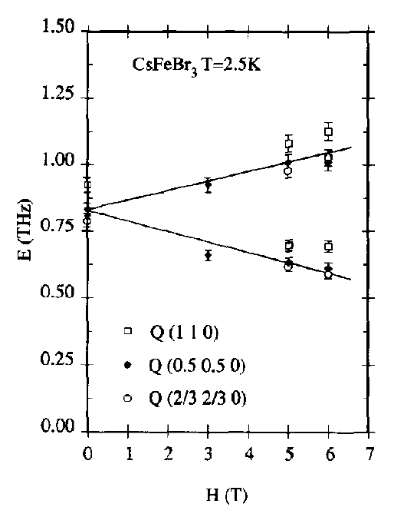
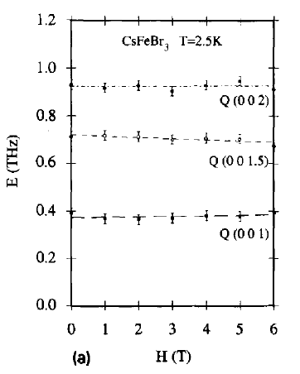
Scattering Exposes S_{z}=0 singlet
Visser, Dorner & Steiner (1991)

Slide 15
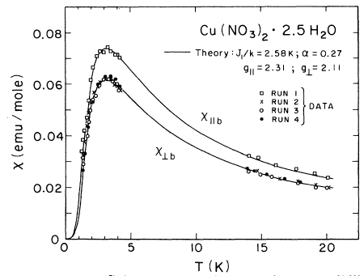
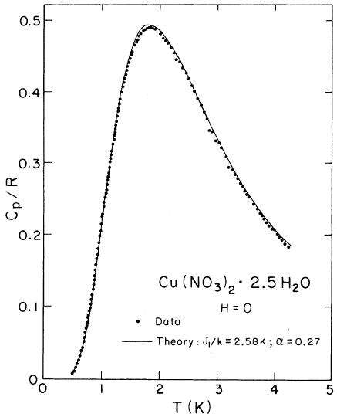
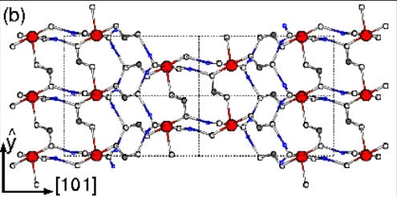
Inter-atomic S=0 singlet?
Notes:
You see a pair of spins with antiferromagnetic interactions have an isolated singlet ground state that is completely isotropic in spin space a far cry from the Neel state
The data shows remarkable bulk properties magnetism goes away. The behavior is much like a that of helium atom. There are two electrons but they form a singlet state and hence magnetism is not appreciable.
However in these systems we are looking at inter-atomic singlet formation. The singlet wave function extends over multiple atoms and in general throughout the sample! There are important conceptual and practical implications of this that we shall explore through this talk.

Slide 16
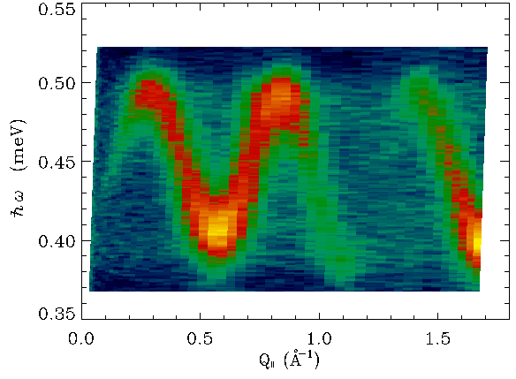
Scattering exposes mobile “triplon”
Xu et al PRL (2000)
Notes:
When instead of plotting the angle integrated intensity we resolve the data versus wave vector transfer along the direction of the interacting pairs one finds this beautiful pattern of scattering. We understand that the spikes in the previous pattern are due to van-hove singularities at the extremes of the dispersive spectrum. The dispersion in turn indicates that neutrons create excitations that physically move through the crystal. We will see that the pattern of intensity provides information about the atomic scale structure of the wave packet in motion.

Slide 17
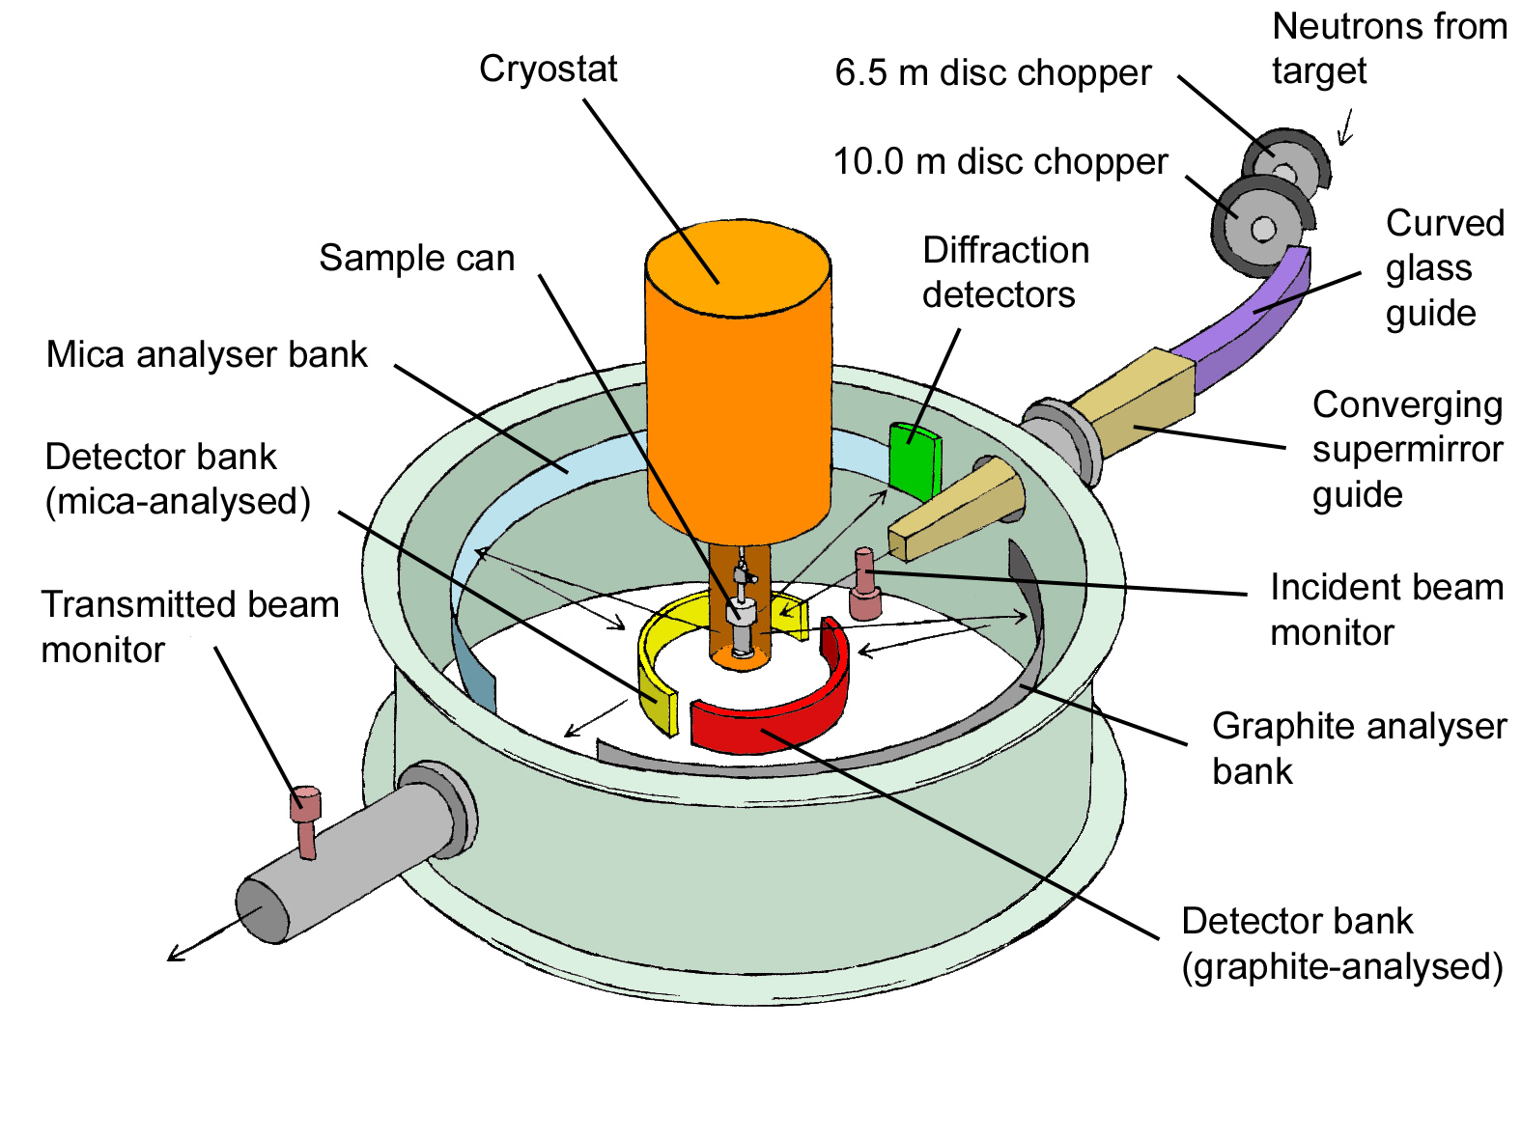
Backscattering spallation neutrons
IRIS@ISIS

Slide 18
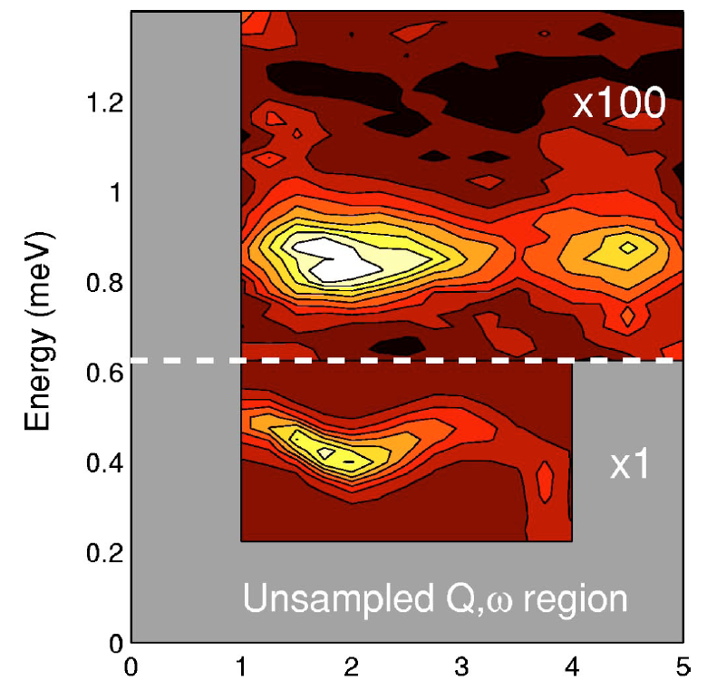

Creating two triplets with one neutron
Copper Nitrate
Two magnons
One magnon
Tennant et al (2000)
Notes:
Here I show experimental evidence for such two magnon states in the alternating spin chain. To the left I show the spectrum of neutron scattering at wave-vector transfer q=2pi. We see elastic nuclear incoherent scattering, uninteresting here but inevitable. Then around 0.5 meV lies the single triplet creation peak, and at twice this energy there is a weak additional peak from triplet pair production. The right hand frames focus on the pair production peaks at 2pi and 3 pi and provide evidence for a spectrum that is significantly broader than the resolution shown with the solid bar in the top frame.
On the right we show data for several values of wave vector transfer in the form of a color contour map of intensity. It is clearly seen that the two magnon excitations are broader in energy than the resolution limited triplet mode as expected. In addition the data is consistent with but does not provide independent evidence for a triplet bound state at q=3pi.

Slide 19
Inter-atomic S=0 singlet w/o dimerization
Magnets with 2S=nz have a nearest neighbor singlet covering
with full lattice symmetry.
This is exact ground state for spin projection Hamiltonian
Excited states are propagating bond triplets separated from
the ground state by an energy gap
Haldane PRL 1983
Affleck, Kennedy, Lieb, and Tasaki PRL 1987

Slide 20
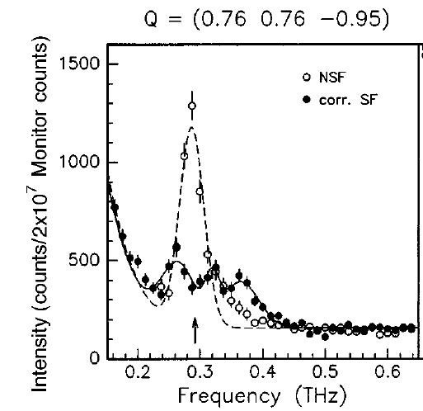
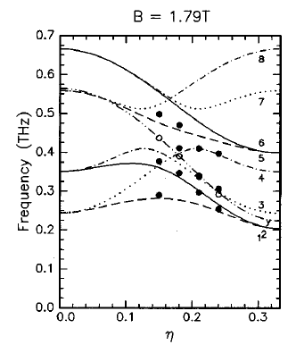
Haldane effect & polarized neutrons
CsNiCl3: isotropic but significant inter-chain interactions
Conventional spin-wave theory fails: Too strong quantum fluctuations
Polarized neutrons find eigenvectors and dispersion of coupled Haldane chains
Enderle et al (1999)

Slide 21
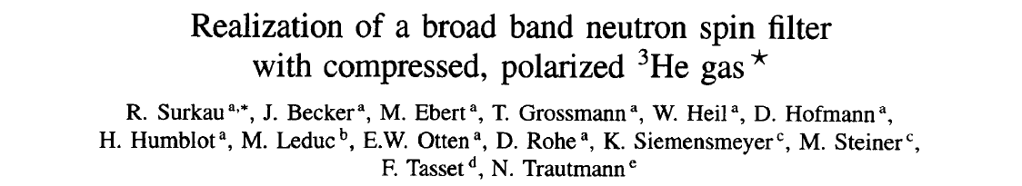
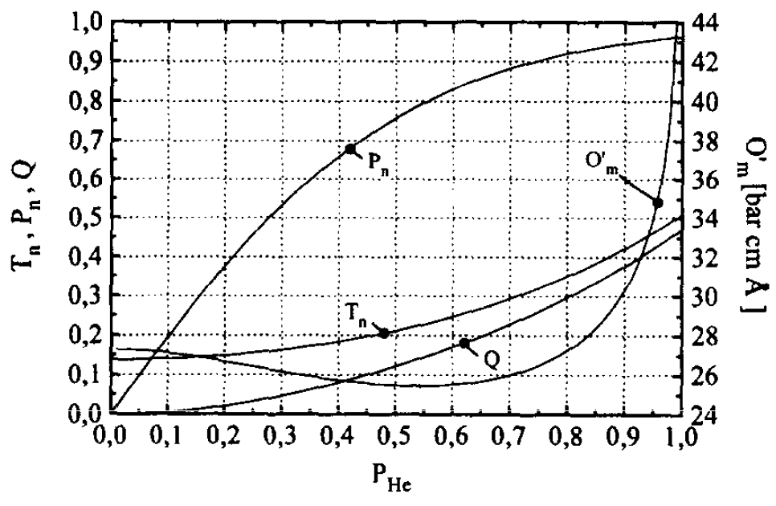
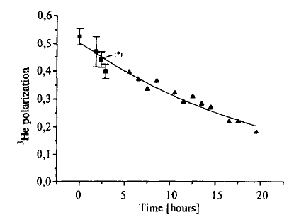
NIM (1997)
Polarized ³He preferably transmits parallel neutron spin state
Polarize ³He through illumination with intense circular polarized light
Ways to absorb photon angular momentum:
  Rubidium gas then collision spin exchange at full pressure
  Dilute ³He plasma + polariztion conserving compression

Slide 22
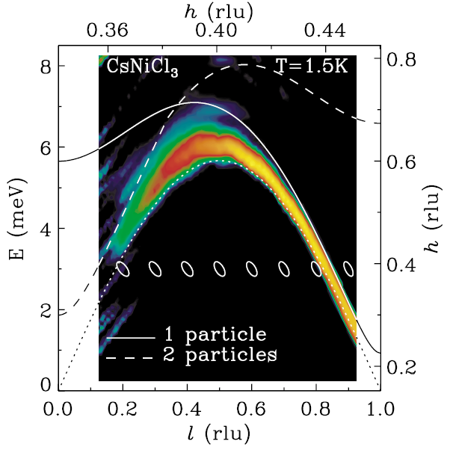
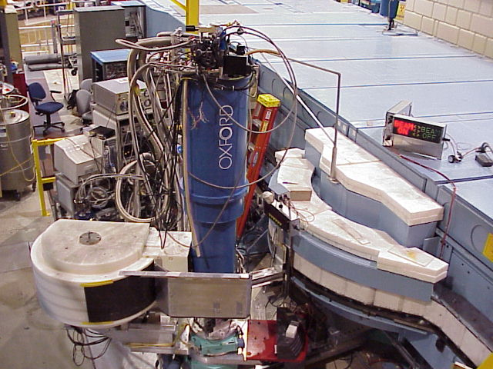
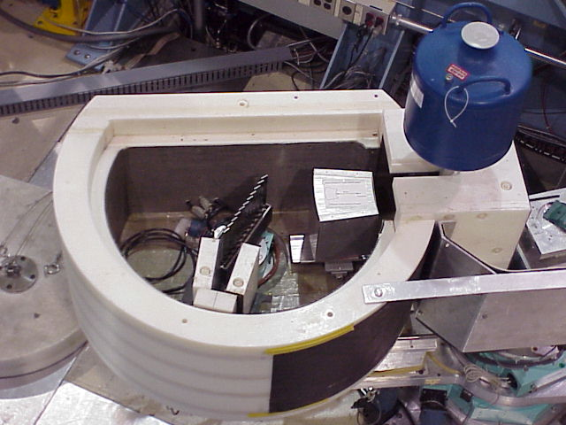
Bound State meets Continuum
Zaliznyak
et al (2004)
Quantum Magnets have bound state & continua
Bound state “protected” by the gap
What if the gap vanishes without symmetry breaking?

Slide 23
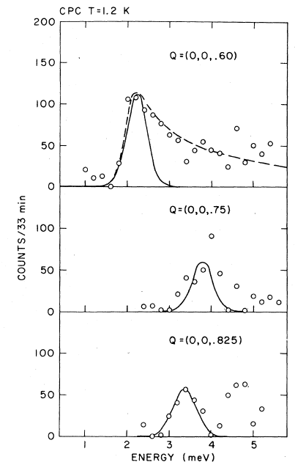
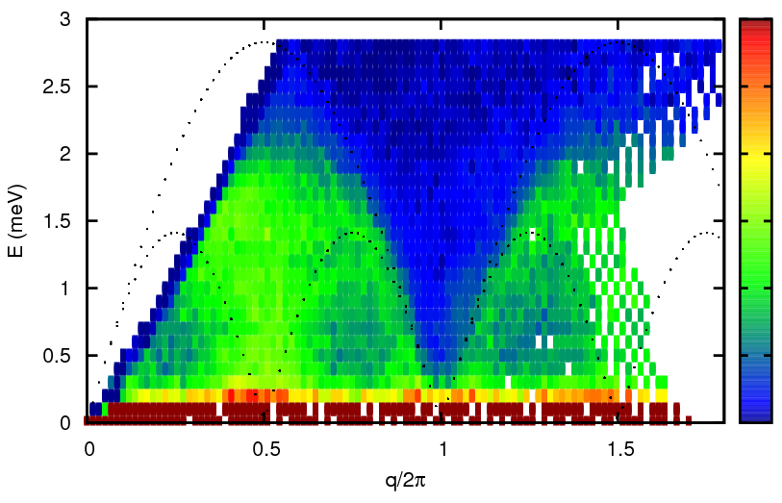
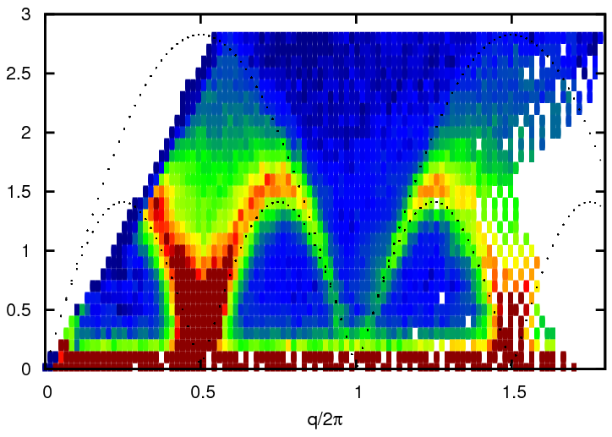
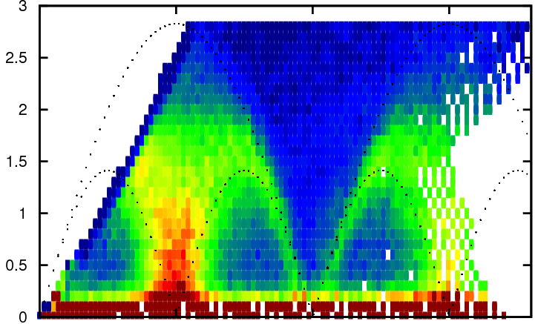
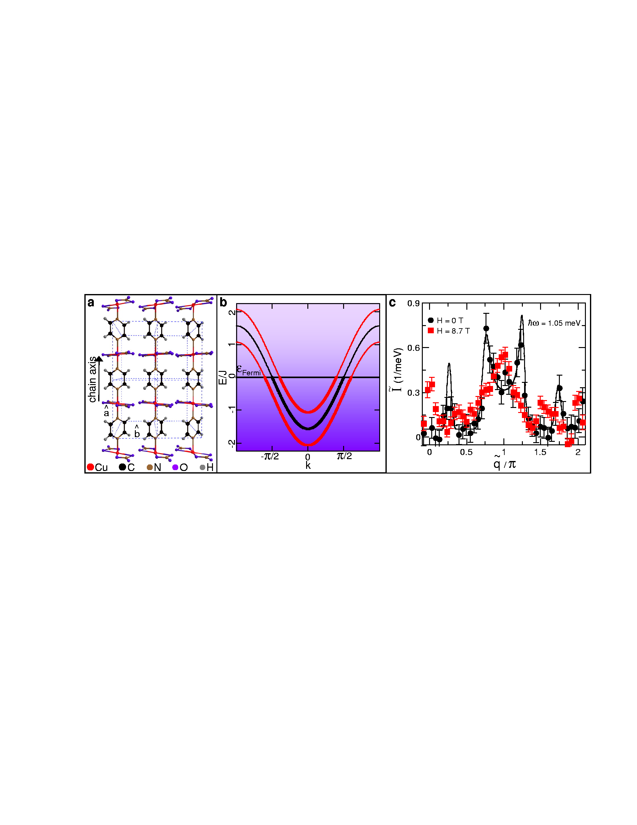
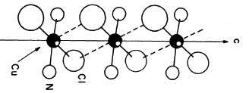
Gapless case: Spin-1/2 AFM chain
T=1.6 K
T=10 K
T=5 K
Heilmann et al (1978)
CuPzN
CPC

Slide 24
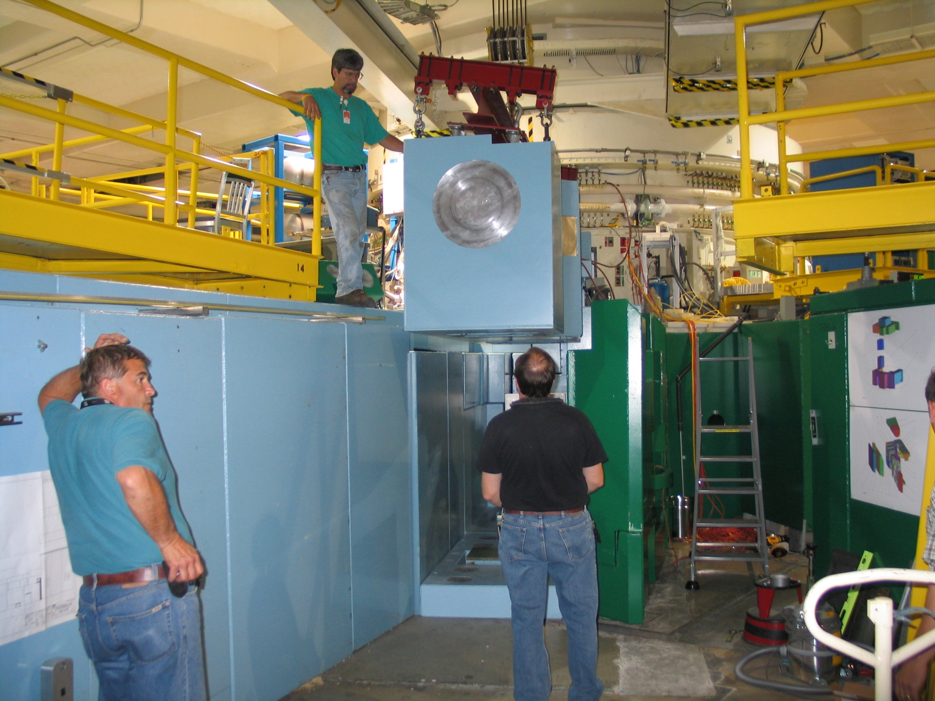
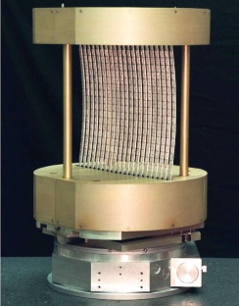
Notes:
Some of the data that I shall show have larger error bars and coarser resolution than optimal. Fortunately help is on the way. A completely new instrument optimized for measurements such as those that you will see today is nearing completion. Here you see the monochromating system built at JHU being lowered into the beam line at the NIST Center for neutron research. Within the cask is what might be the worlds largest doubly focusing neutron monochromator. It contains 351 2 by 2 cm graphite platelets and subtends a 40 times larger solid angle to the cold neutron source than any other instrument of its type.

Slide 25
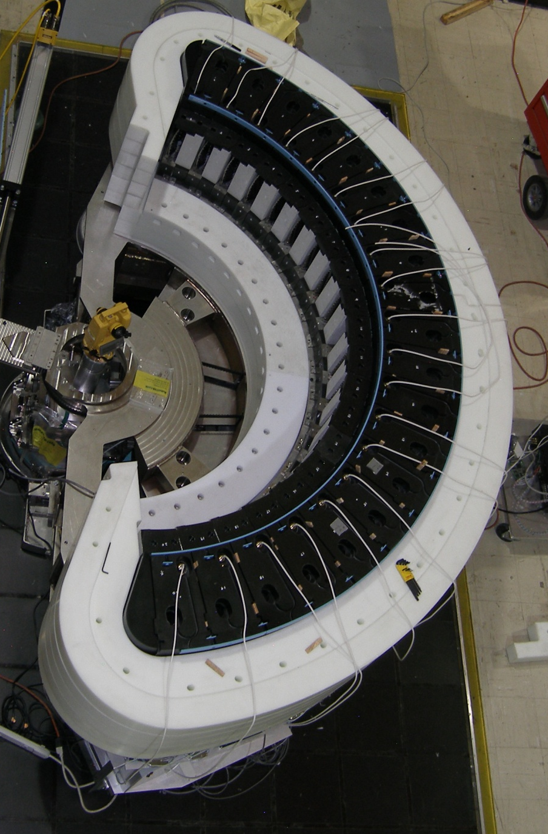



Multi Channel SpectrDetector
Notes:
These images taken some months ago show that it is more than just a dream in a CAD system. We have actually built, assembled and aligned the many crystal analyzers. Shielding has now been assembled around these devices and detectors added and we look forward to the large solid angle detection system joining up with the most intense neutron beam in the world later this year.

Slide 26



Commissioning MACS

Slide 27


Two & one-particle scattering in spin chains
CuCl₂.2(DMSO):
Spin-1/2 chains in a crystal
Kenzelmann et al. PRL (2004)
Notes:
Case in point is CuCl2DMSO. Magnetism is associated with copper II ions coupled to form an ensemble of independent spin chains.
Each spin seeks singlet formation with its neighbor but failing to break right left symmetry the system remains in a critical state.
The gapless continuum indicates that neutrons interact with spin chains through a two particle process as expected for a quantum critical spin system.
The clearest indication however of criticality is the high sensitivity to perturbations. So lets apply a high magnetic field to the sample. The field experienced by the CuII ion actually depends on the coordinating surroundings and since that rotates from site to site the uniform field actually is modulated or staggered along the spin chain.
The effect of this perturbation is dramatic. While a continuum remains at the highest energies, Much of the spectral weight has collected into sharp resonant modes.
Hence the application of a site modulated magnetic field has the effect of changing the dominant scattering process from two to a one particle scattering.

Slide 28
Why staggered field yields bound states
Zero field state quasi-long range AFM order
Without staggered field distant spinons don’t interact
With staggered field solitons separate “good” from “bad”
domains, which leads to interactions and “soliton” bound state
Notes:
A staggered field should have a major qualitative impact on the spin chain. This can be traced to the fact that it is a spatial symmetry breaking field. At the microscopic level the mechanism is as follows:
Without a staggered field there are two degenerate spin configurations that differ from each other by a phase shift of pi.
Spinon’s are boundaries between these different spin configurations. As a result of the degeneracy distant spinons don’t interact hence the gapless continuum.
However, the staggered field favors one domain over the other so that spinons become boundaries between domains with different energies. The result is long range forces between spinons which form bound states. Thus what used to be a two particle continuum becomes distinct resonant modes of excitations.

Slide 29

From Frustration to Quantum Criticality?
pyrochlore
Frustration &
weak connectivity
stunt growth of correlations
Triangular
Quantum Magnetism
Kagome

Slide 30




Frustrating Outcomes:
Lattice distorts Long range order
Weak disorder Spin freezing
Stock et al. (2009)
NiGa₂S₄
40 K
15 K
ZnCr₂O₄
1.5 K
S. H. Lee et al. (2000)
Nakatsuji et al (2006)

Slide 31



Frustration + Fermions=Spin Liquid ?
La₂CuO₄ Coldea et al 2001
κ-ET₂Cu₂CN₃ Kurosaki et al (2005)

Slide 32

Why the fuss about quantum criticality?
T/J
Heavy Fermion behavior
Non-fermi-liquids
High T_{C} Superconductivity
Quantum Critical
1/S, frustration, 1/z, H, P, x, ...

Slide 33
Summary
Elements of Steiner’s career in magnetism
  Evidence for solitons in easy plane FM CsNiF3
  Evidence for atomic singlet ground state in CsFeF3
  Resolving Coupled Haldane modes in CsNiCl3
Advancing scientific boundaries by new Instruments
  Pulsed source instrumentation for high & low E
  New generations of crystal spectrometers
  Polarized ³He and polarized neutrons
  Sample environment systems
A view of current trends in quantum magnetism
  Fractionalized quasi-particles
  Quantum criticality
  Frustration and Fermions

