Slide 1

Spin Resonance in Superconductors Near Magnetic Instabilities
Collin Broholm
Johns Hopkins Institute for Quantum Matter
Superconductivity & spin fluctuations
CeCoIn5
  Spin resonance
  ZEEMAN effect
  Condensation energy
FeSe_{x}Te_{1-x}
  Spin resonance
  Competition for momentum space
Conclusions
Notes:
First thank the organizers for the invitation to this exciting conference. I also thank you for coming as there are many choices!
This talk is about our recent discovery of spin resonances in two magnetic superconductors. In succession I shall discuss our findings in CeCoIn5 and FeSeTe. Despite the many chemical and physical differences between these materials, in the resonance there are striking analogies that I shall emphasize.
The different energy scales enables different details to be explored. For CeCoIn5 I shall discuss our observation of the ZEEMAN effect and use of the first moment sumrule to extract a macroscopic energy for comparison to specific heat data.
For FeSeTe I shall discuss intricate competition between magnetism and superconductivity revealed in a complex temperature dependent pattern in momentum space.

Slide 2



Collaborators
Funding:
CeCoIn5 (PRL 100, 087001 (2008))
  C. Stock, ISIS
  Y. Zhao, IQM-JHU
  H. J. Khang, NIST
  C. Petrovic, BNL
FeSe_{0.4}Te_{0.6} (PRL 103, 067008 (2009))
  Y. Qiu, NIST
  W. Bao, Remnin Univ.
  Y. Zhao, IQM-JHU
  V. Stanev, IQM-JHU
  Y. C. Gasparovic, NIST
  S. Chang, NIST
  J. Hu, Tulane U.
  B. Qian, Tulane U.
  M. Fang, Tulane U.
  Z. Mao, Tulane U.
FeSe_{0.4}Te_{0.6} (Unpublished)
  W. Bao, Remnin U.
  V. Thampy IQM-JHU
  J. Wen IQM-JHU
  J. Rodriguez NIST
Neutrons:
Notes:
This is work carried out over the last couple of years by the following collaboration. Funding is provided by DoE and NSF and the experiments were carried out at the ISIS and NIST neutron scattering facilities.

Slide 3
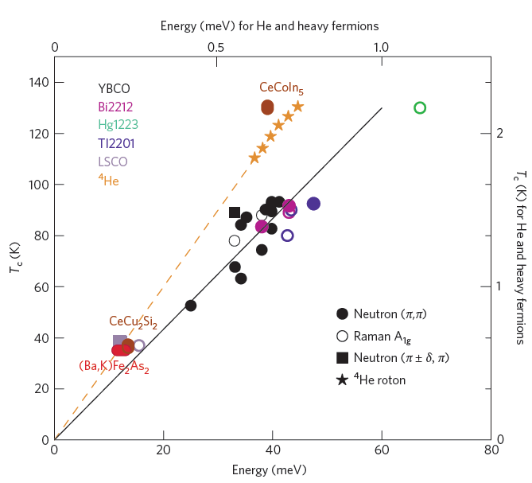
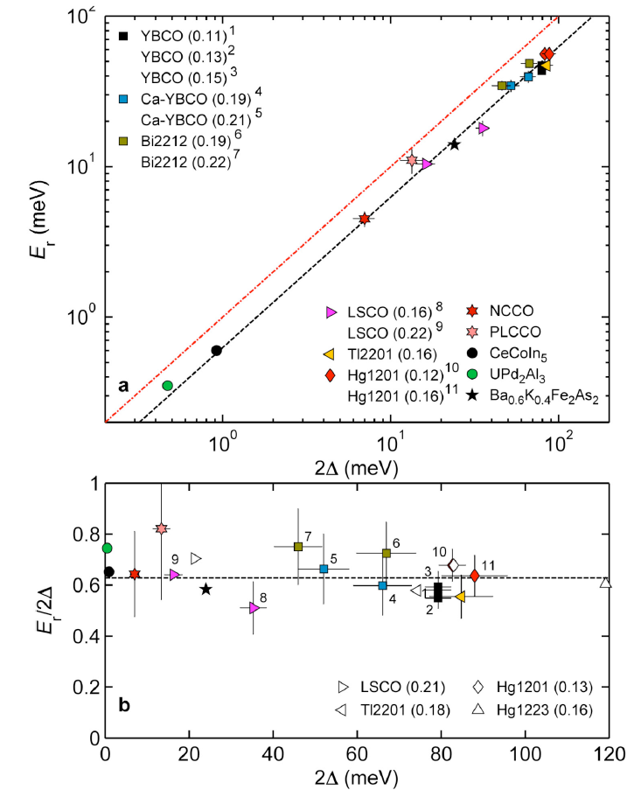
Ubiquitous Resonances when Order Parameters Compete
Notes:
Tomo Uemura has pointed out in a recent Nature article that a wide range of materials where order parameters compete feature a resonant excitation at an energy that roughly scales with the ordering temperature. Most of the examples involve materials with competing magnetic and superconducting order parameters. However, the superfluid to solid transition in helium 4 is another example.
Focusing on superconductivity, Martin Greven finds that the scaling is best between the resonance energy and the superconducting gap amplitude. In other words these materials share a bound state that sits approximately 65% of the gap amplitude.
This extraordinary similarity in behavior across a wide range of chemical systems prompts a hypothesis that there is a common mechanism for superconductivity in these materials. It also suggests that the formation of the resonance may in some sense drive the system towards superconductivity.
These are phenomenological observations that our community is of course engaged in evaluating. In this talk I shall examine two particular examples of superconducting spin resonances in a heavy fermion system and in one of the new iron based superconductors.

Slide 4
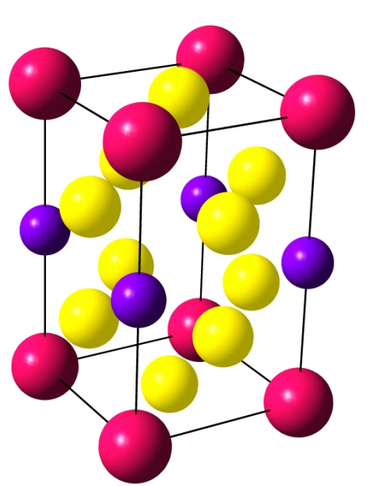
A family of strongly correlated metals
Fisk, Thompson, Petrovic,…
CeCoIn₅ : HF superconductor T_{c}=2.3 K
CeIrIn₅ : HF superconductor T_{c}=0.38 K
CeRhIn₅ : HF Antiferromagnet T_{N}=3.8 K
Notes:
CeCoIn5 is part of a family of tetragonal heavy fermion systems that was discovered about a decade ago at LANL. The resistivity is dominated by spin disorder scattering all the way to room temperature indicating Kondo lattice physics.
There are various low T states spin density waves and superconductivity and as we shall see this superconductivity turns out to be non-conventional d-wave superconductivity.

Slide 5
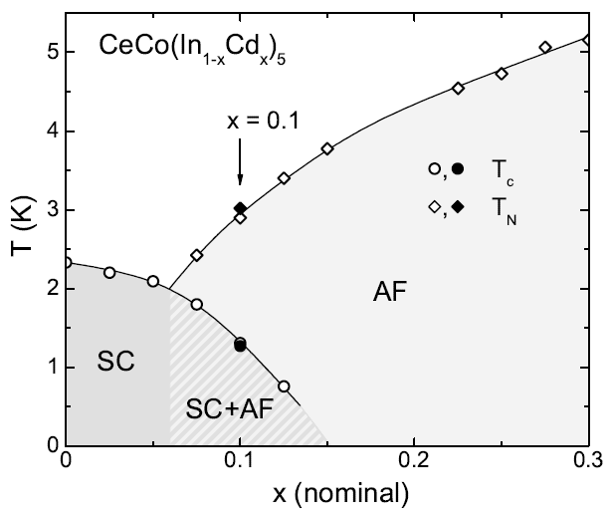
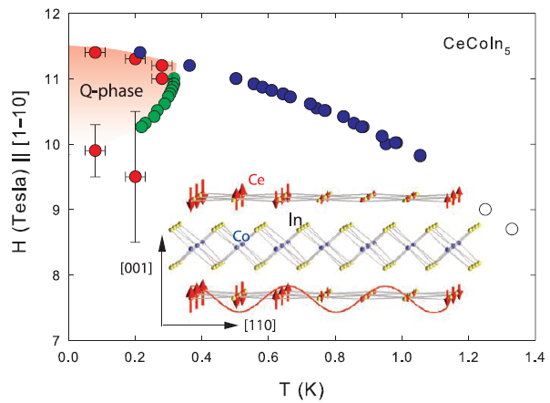
Proximity to magnetism in CeCoIn₅
Nicklas et al. (2007)
Kenzelmann et al (2008)
Notes:
The competing phases of CeCoIn5 are magnetism and superconductivity. while the pure sample superconducts small amounts of cadmium doping lead to a magnetic state and there are indications of homogeneous co-existence of these order parameters in some compositional range.
However, even in undoped CeCoIn5 application of a magnetic field reveals an intricate interplay between magnetism and superconductivity. A recent neutron diffraction experiment by Kenzelmann et al from PSI revealed a mixed superconducting and incommensurate magnetic state at high fields. This additional phase was previously detected by NMR and considered a possible example of an FFLO phase.
So CeCoIn5 is a good candidate for displaying a superconducting spin resonance and we set out to look for that.

Slide 6
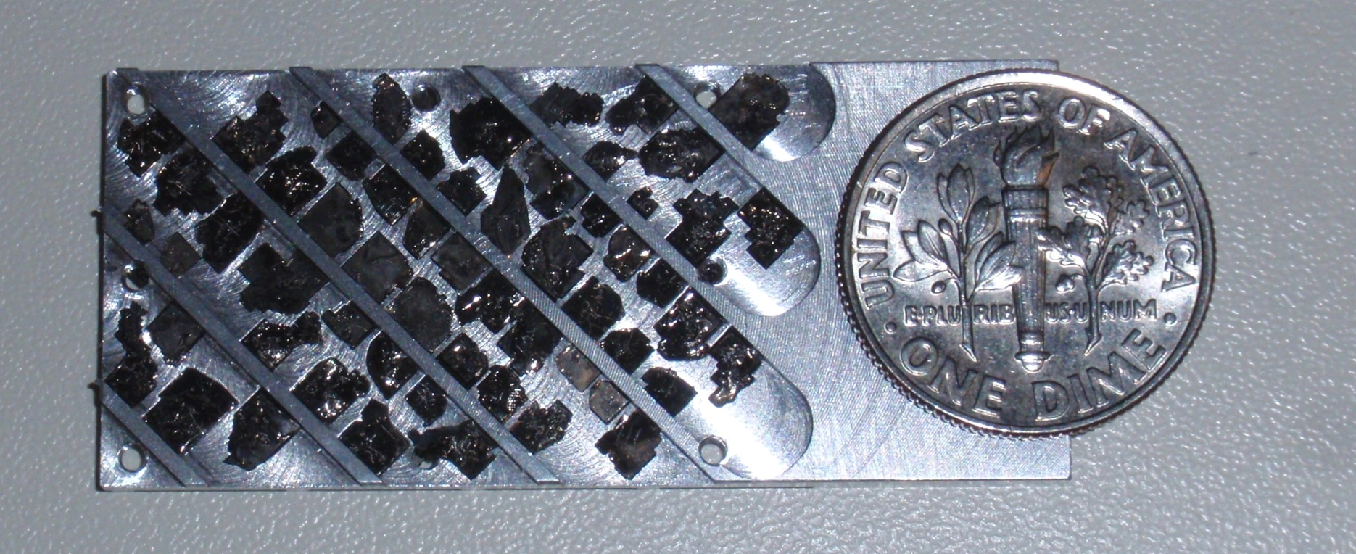

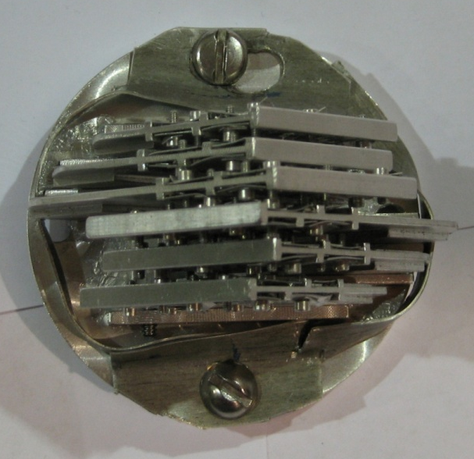
Aligning platelets for inelastic scattering
CaFe2As2
~300×10 mm² x-tals
Fixed by Fomblin H-free pump oil
Edge aligned
3º FWHM mosaic
CeCoIn₅
CeCoIn₅
Notes:
What made the experiment possible was the development of a sample co-mounting technique in which small crystals can be assembled in the hundreds to gain enough intensity for inelastic scattering.
The nicest picture is of a CaFe2As2 sample mount on the top. CeCoIn5 was the precursor to this. We use H-free fomblin pump oil to hold hundreds of crystals in place aligned against crystalline edges.
Remarkably the mosaic distribution of such mounts can be less than 2 degrees in some cases and we have made small diameter mounts that can go into superconducting magnets and be cooled to 50 mK.

Slide 7

AFM Short Range Order
Ǻ
Ǻ
Notes:
Here are inelastic scattering data versus wave vector transfer parallel and perpendicular to the tetragonal basal plane. There is a peak at (0.5,0.5,0.5) corresponding to the following short range order.
From the width of the peak we obtain correlation lengths of 7 and 10 AA respectively along C and in the basal plane. The correlation length anisotropy is planar but not as pronounced as other electronic properties such as the Fermi surface.
In these figures open and closed circles indicate data in the normal and superconducting states respectively. One sees a substantial enhancement in the intensity of magnetic scattering at this particular energy transfer. However, looking at lower energies the magnetic intensity is reduced at low temperatures. Evidently there are changes in the spectrum upon cooling below Tc and these are examined in the next slide.

Slide 8
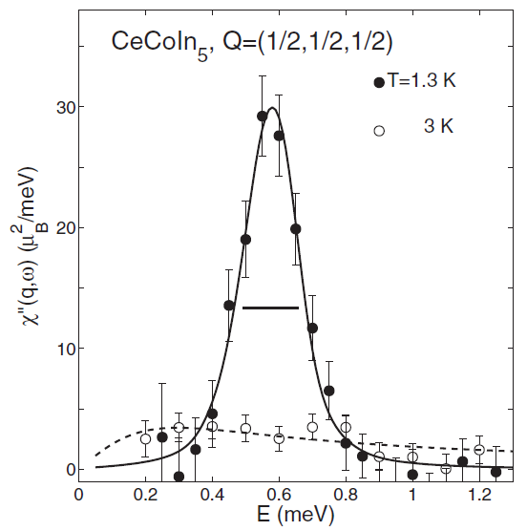
Spin Resonance in Superconducting CeCoIn₅
Normal State: relaxation
Superconductor: Resonance
Notes:
Here we have fixed wave vector transfer at the critical wave vector and we have converted the raw data into normalized information regarding the imaginary part of the generalized spin susceptibility.
While in the normal state one finds an overdamped continuum with a relaxation rate of 0.3 meV, there is a sharp resonance at an energy of 0.55 meV in the superconducting state. Note though that the resonance is not quite resolution limited and we shall return to stronger evidence for this from a higher resolution instrument later in the talk.

Slide 9
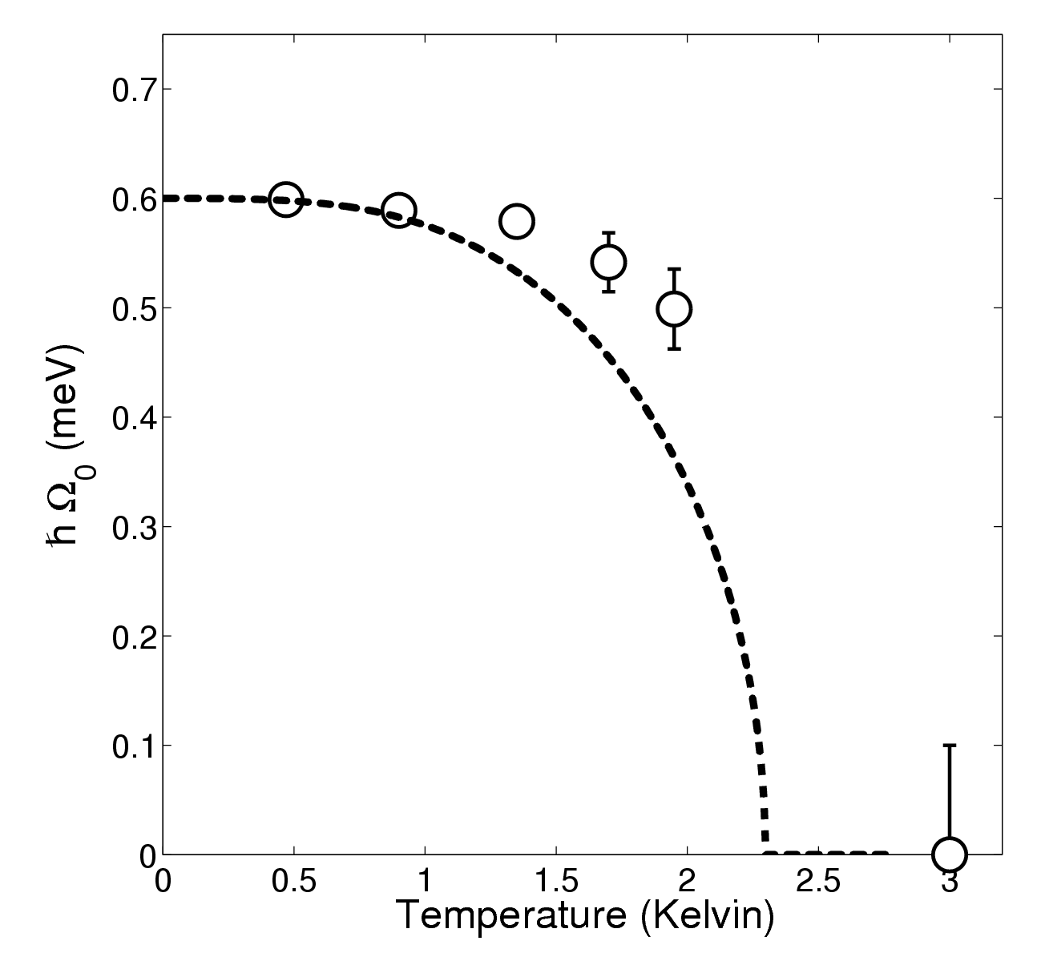
Development of the Resonance
T (Kelvin)
T (Kelvin)
Resonance energy less T-dependent than expected for Δ(T)
Increased Damping is largest effect
of heating through T_{c}
4/14/2008
Notes:
Here are raw data showing the temperature dependence of the resonance through Tc. One sees perhaps a slight reduction in the resonance energy on heating but in fact the dominant effect is the appearance of damping so that the spectrum eventually becomes overdamped.

Slide 10
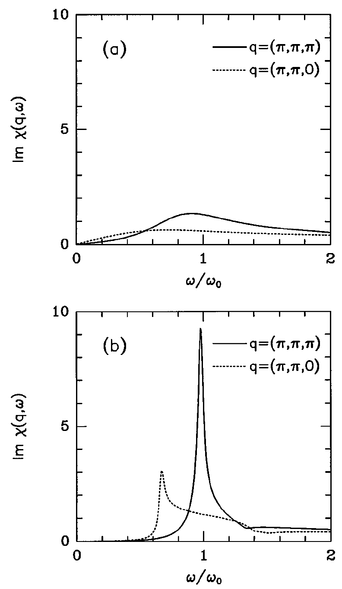
Theory of Spin-Resonance
Bulut & Scalapino (1993)
Resonance in CeCoIn₅
Notes:
Clearly we have an excitation that is tied to superconductivity. A natural interpretation is that of a bound state that can come out of an RPA treatment of an exchange enhanced BCS response function.
This affords a connection between the wave vector at which the resonance is observed and the symmetry of the superconducting order parameter. Bulut and Scalapino pointed out that the intensity of the resonance is enhanced due to coherence factors at wave vectors that reverse the sign of the superconducting gap function.
For CeCoIn5 the resonance indicates a sign change for a diagonal wave vector. Glossing over the out of plane component, this implies a px^2-py^2 superconducting order parameter that is consistent with tunneling data.
But there are alternative explanations and distinguishing between them invariably leads us into a discussion of the distinction between itinerant and localized electrons. More experimental results will be important to establish the correct understanding of this effect.

Slide 11
From INS to macroscopic energy
Zero-moment sum-rule (Scalapino & White, Demler & Zhang ):
First-moment sum-rule (Hohenberg & Brinkman):
To use it we must know the form of the spin Hamiltonian
Notes:
Going back to the zero field spin resonance it is clearly a major rearrangement of spectral weight and correspondingly must represent a significant change in thermal energy.
This can be quantified when there is a good understanding of the underlying Hamiltonian. Previous work on this in copper oxides relied on the zero moment sum-rule. Here we use the first moment sum-rule which relates an energy weighted integral of scattering to the thermal expectation value of a certain double commutator.
Since on account of the form factor we are probing 4f electrons here, we use an effective low energy hamiltonian for the 4f electron system where other degrees of freedom have been integrated out.

Slide 12
Which term has T-dependence?
Kondo:
Crystal field
RKKY Exchange
Notes:
There are three terms and we shall identify which has the dominant t-dependence by comparing the corresponding Q-dependence of the double commutator to the data.
Both the Kondo and the crystal field terms are single ion in nature and produce a q-independent result.
The RKKY exchange term on the other hand yields a specific cosine q-dependence related to the spacing between spins.

Slide 13

Changes in are Q-dependent
Changes in near neighbor
RKKY exchange dominate
through T_{C}
Compare:
To net condensation energy
Notes:
We find experimentally that chnages in S(qw) are strongly q-dependent and this allows us to identify the RKKY term as the one whose thermal expectation value is changing across Tc. Fully neglecting other terms produces this expression that can readily be evaluated from the neutron scattering data. Essentially it corresponds to treating chi” as a density of states. We shall compare that energy change to that extracted from the specific heat.

Slide 14
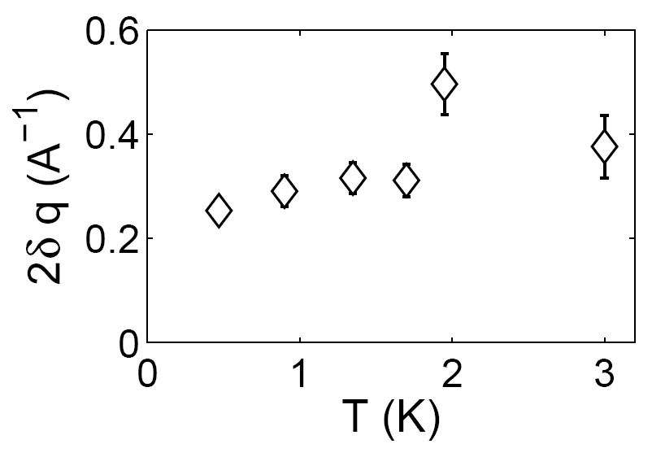
Spin Exchange energy versus T
Appearance of q-dependent resonance indicates energy reduction through RKKY
The correlation length however does not change substantially
Notes:
One finds that there is a substantial lowering of the spin exchange energy to the tune of approximately one meV per 4f spin. This is substantially less than the small reduction in thermal energy across Tc and occurs without a change in the correlation length.
Simple accounting indicates that there must be a corresponding rise in the kinetic energy of the conduction electron system that can be measured through the f-sum rule in optics. Work is in progress to do this.
From a simple minded perspective it does appear however that the energetic advantage of going superconducting is associated with lowering the RKKY exchange energy and forming the spin resonance.

Slide 15

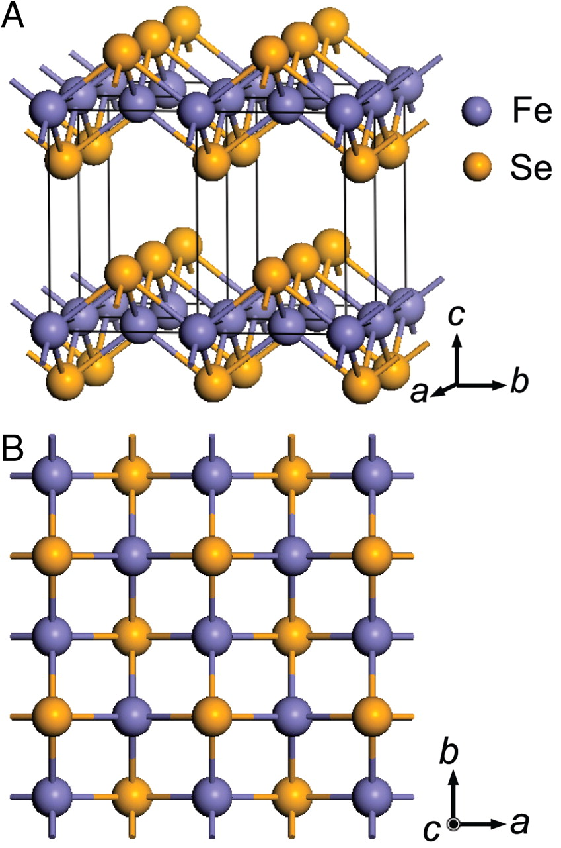
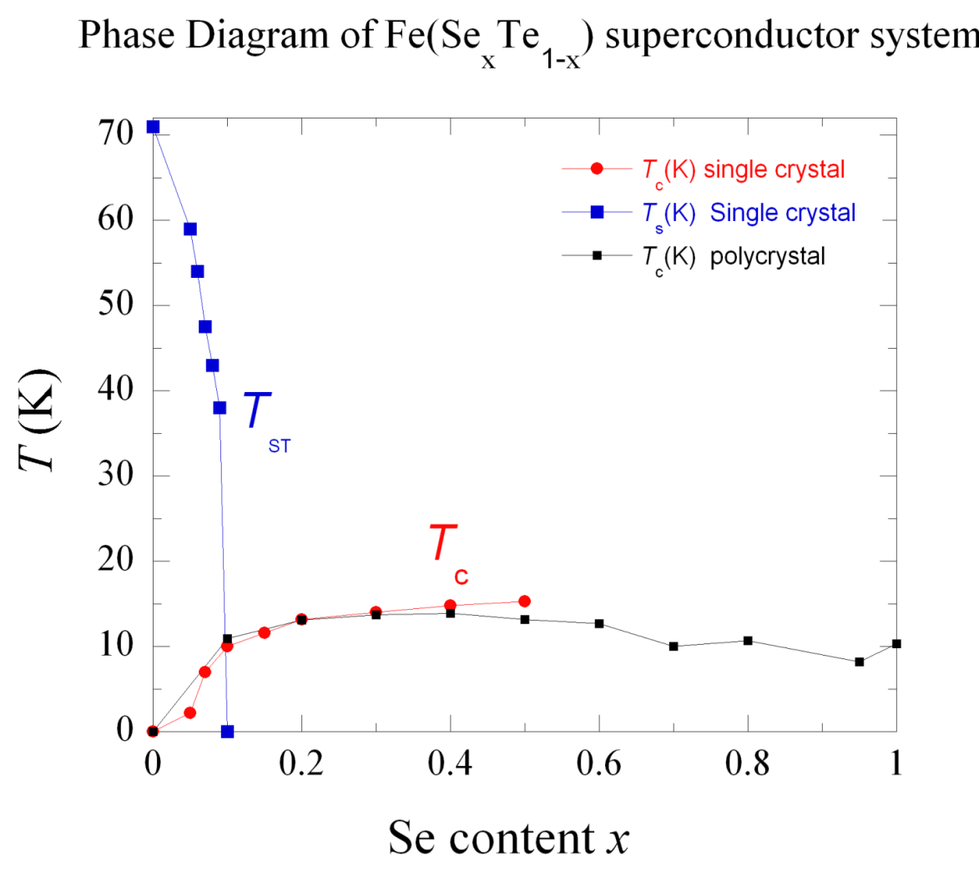
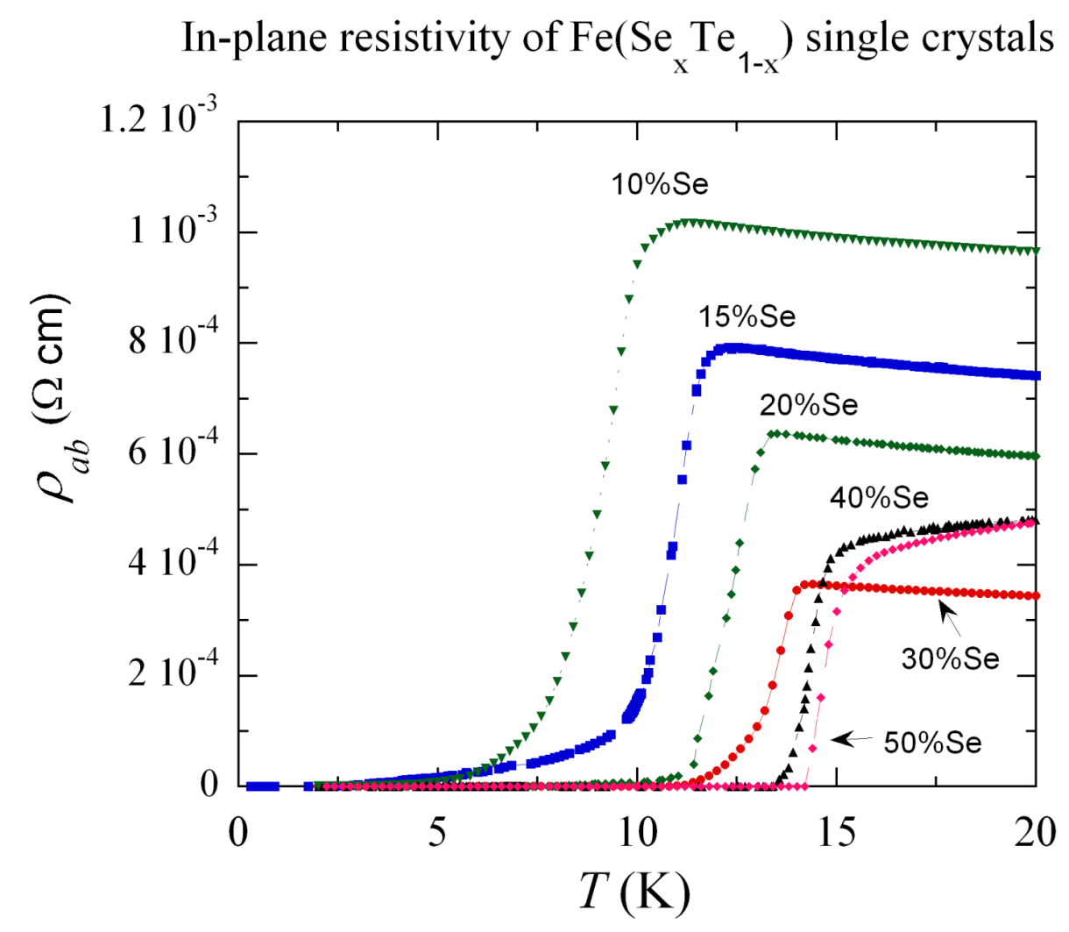
Superconductivity in FeSe_{0.4} Te_{0.6}
~20 mm
Hsu F et al. PNAS 2008;105:14262-14264
Z. Mao et al. (2009)
Notes:
We now turn to the 11 compound which is all business. Even pure FeSe is superconducting. With the addition of Te the transition temperature can be slightly increased and large single crystals can be grown. Te doping demonstrates proximity to a magnetic phase that has been shown to be an incommensurate spin density wave.
First I shall summarize our discovery of the spin resonance from the spring, then go to the new results on Q dependence of the magnetic fluctuations.

Slide 16
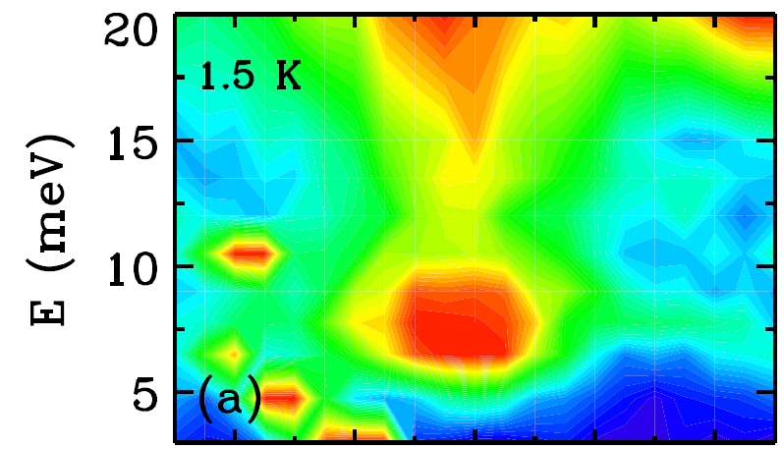
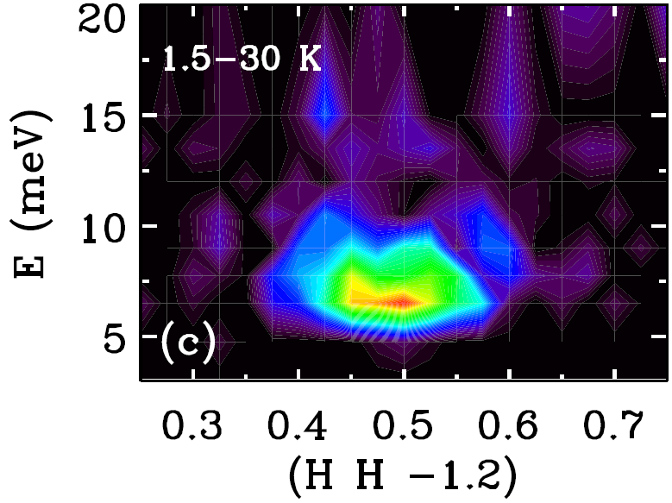
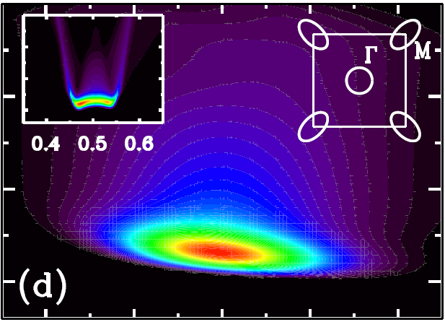
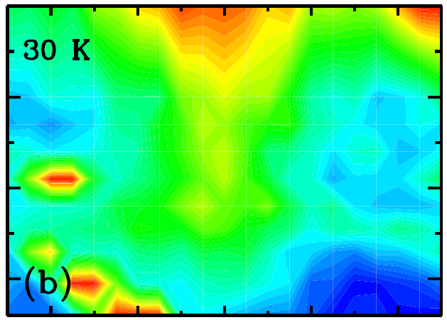
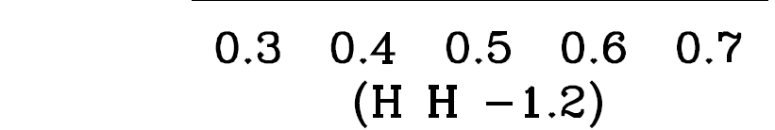
Spin Resonance in FeSe_{0.4}Te_{0.6}
Qiu et al. PRL (2009)
Notes:
This shows the main results. This is inelastic neutron scattering as a function of Q and E in the normal and superconducting states. The low energy ridge versus Q indicates an incipient nesting instability. In the superconducting state spectral weight moves from low energies to a resonance at 8 meV. This is about 5.1 Tc as in a wide range of anomalous supeerconductors close to AFM.
The difference data shows that the changes in the spectrum are concentrated at 8 meV. The RPA theory previously reviewed can also account for these findings and here we show a calculation that takes into account the band structure as inferred from ARPES.

Slide 17
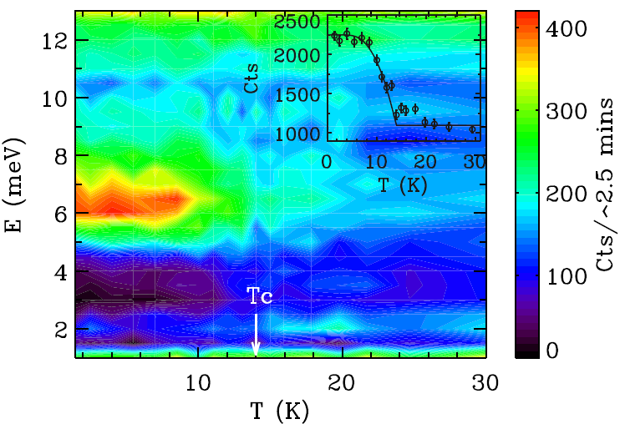
Onset of resonance at T_{c}
FeSe_{0.4}Te_{0.6}
Notes:
Evidence that the resonance is associated with superconductivity is apparent from the temperature dependence. As in CeCoIn5 there is little temperature dependence to the resonance energy on heating. It simply sits firm at 6.5 meV and looses spectral weight on heating.

Slide 18
Summary
Superconducting CeCoIn5 and FeSeTe both have spin resonance excitations at similar reduced energies
Heavy Fermion CeCoIn5:
  First moment sum-rule indicates d-wave superconductivity is stabilized by a reduction of RKKY exchange energy
  ZEEMAN splitting indicates a spin-doublet resonance
Iron superconductor FeSe_{0.4}Te_{0.6}:
  Complex Wave vector dependence in indicates competing nesting instabilities
  Frozen short range spin correlations coexist in the optimally doped sample but are unaffected by superconductivity.
Detailed characterization of the field and wave vector dependence of the spin resonance in a range of magnetic superconductors is needed to elucidate its significance
Notes:
We have plans in upcoming experiments to extend this type of mapping to higher energies and invite theoretical work to account for these effects.
In summary

